Slide 1
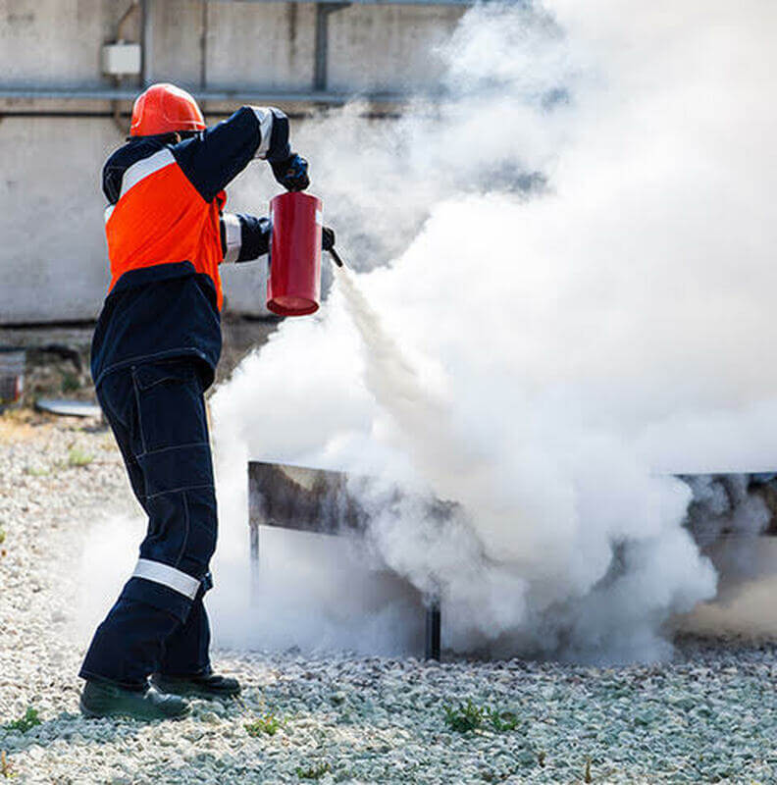

CDRTs &
Incident Management
For Community Disaster Response Teams

Slide 2





Acknowledgements
We thank the Red Cross Aruba, Barbados Red Cross, Guyana Red Cross, Netherlands Red Cross Red Cross, and the Sint Maarten Red Cross for their commitment to collaborating with the Caribbean Disaster Risk Management (CaDRiM) Reference Centre. Together, we reviewed and revised the CDRT Training Material, enhancing its relevance and effectiveness in disaster response training. Your dedication exemplifies the spirit of cooperation within the humanitarian
community, and we deeply appreciate your invaluable contributions.

Slide 3

Objectives
Understand the basics of Incident Management
Understand the principles of tactical and strategic incident management
Identify 5 major management functions
Identify the different roles and functions in ICS
Understand the principle of Span of Control
Identify the facilities used in ICS
Practice setting up a sample scene control layout

Slide 4
What is ICS?
Standardized, on-scene, all-hazard incident management concept.
Allows its users to adopt an integrated organizational structure.
Has considerable internal flexibility.
A proven management system based on successful business practices.
The result of decades of lessons learned in the organization and management of emergency incidents in the US.

Slide 5
Lack of accountability, including unclear chain of command and supervision.
Poor communication, including system and terminology problems.
Lack of an orderly, systematic planning process.
No common, flexible, predesigned management structure.
No predefined methods to integrate interagency requirements into the management structure and planning process.
Weaknesses Addressed By ICS

Slide 6
Meet the needs of incidents of any kind or size.
Allow personnel from a variety of agencies to meld rapidly into a common management structure.
Provide logistical and administrative support to operational staff.
Be cost effective by avoiding duplication of efforts.
ICS has been tested in more than 30 years of emergency and non-emergency applications, by all levels of government and in the private sector in the US.
What ICS Is Designed To Do

Slide 7
ICS Features
ICS Organisation
Common Responsibilities
Incident Action Plan
ICS
Span of Control
Incident Facilities

Slide 8
Five Major Management
Incident Command
Operations Section
Planning Section
Logistics Section
Finance/ Administration Section

Slide 9
ICS Span Of Control
Supervisor
Resource 1
Resource 3
Resource 2

Slide 10
Managing Span Of Control
Supervisor
Resource 1
Resource 3
Resource 2
Resource 4
Resource 5
3 to 7 resources

Slide 11
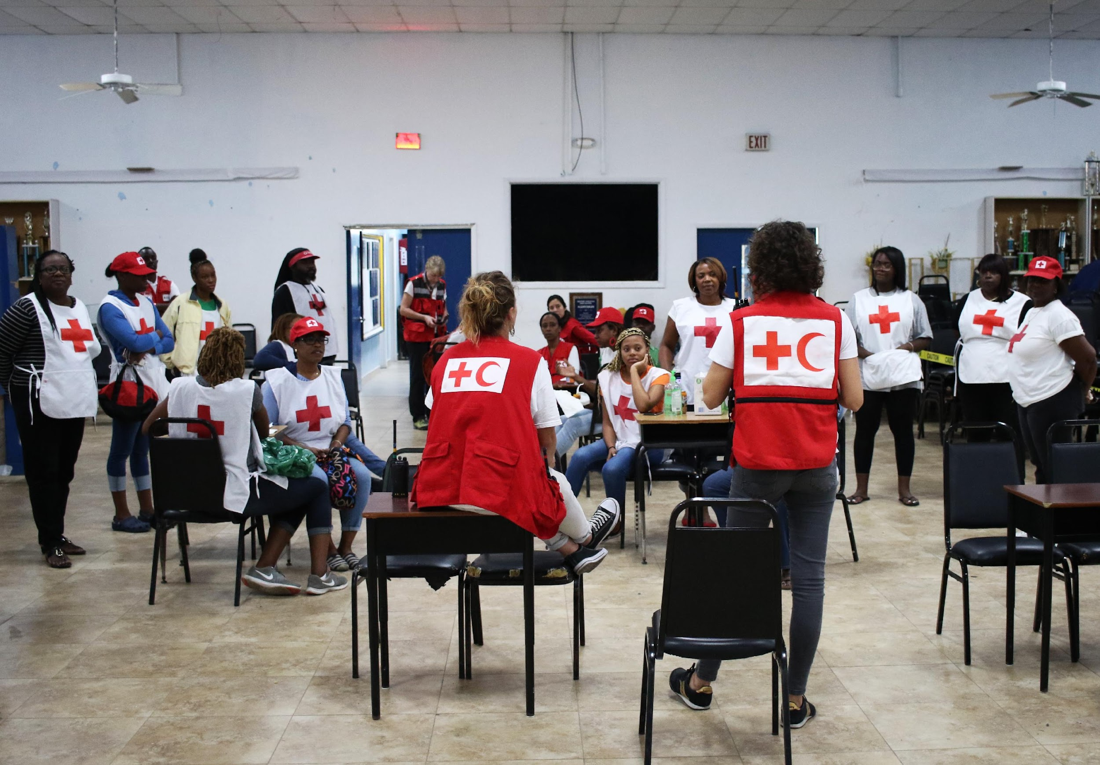
Provide a common standard for all users.
Distinct titles allow for filling positions with the most qualified individuals.
Useful when requesting personnel.
ICS Position Titles

Slide 12
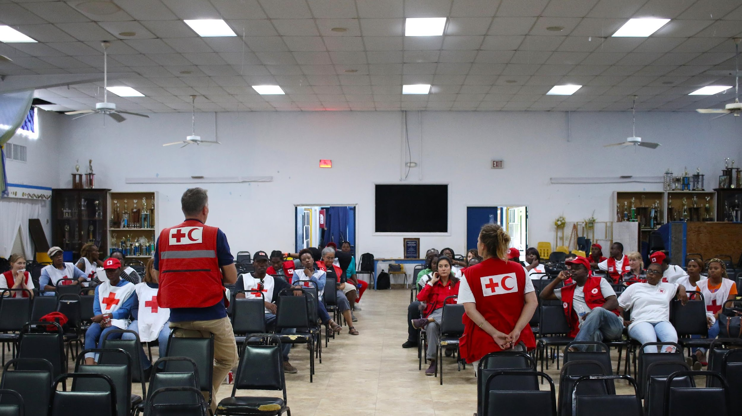
ICS Organisational Components
Section
Division
Group
Branch
Task Force
Strike Team
Single Resource

Slide 13
Managing Span Of Control
Divisions: Divide incident geographically, led by a Supervisor.
Groups: Describe functional areas of operation, led by a Supervisor.
Branches: Used when the number of Divisions or Groups exceeds the span of control and can be either geographical or functional, led by a Director.

Slide 14
Managing Span Of Control
Task Forces: Mixed resources with common communications reporting to a Leader.
Strike Teams: A set number of resources of the same kind and type with common communications reporting to a Leader.
Single Resources: Individuals, a piece of equipment and its personnel complement, or a crew or team of individuals.

Slide 15
Role Of The Incident Commander
Has overall responsibility for managing the incident.
Must be fully briefed, and should have a written delegation of authority.
Personnel assigned by the Incident
Commander have the delegated authority of their assigned positions.
Only position that is always filled.

Slide 16
Expanding The Organisation
Incident Command
Public Information Officer
Safety Officer
Command Staff:
The Command Staff provide Information, Safety, and Liaison services for the entire organization.
Liaison Officer
General Staff:
The General Staff are assigned functional authority for Operations, Planning, Logistics, and Finance/Administration.
Operations Section
Planning Section
Logistics Section
Finance/ Administration Section

Slide 17
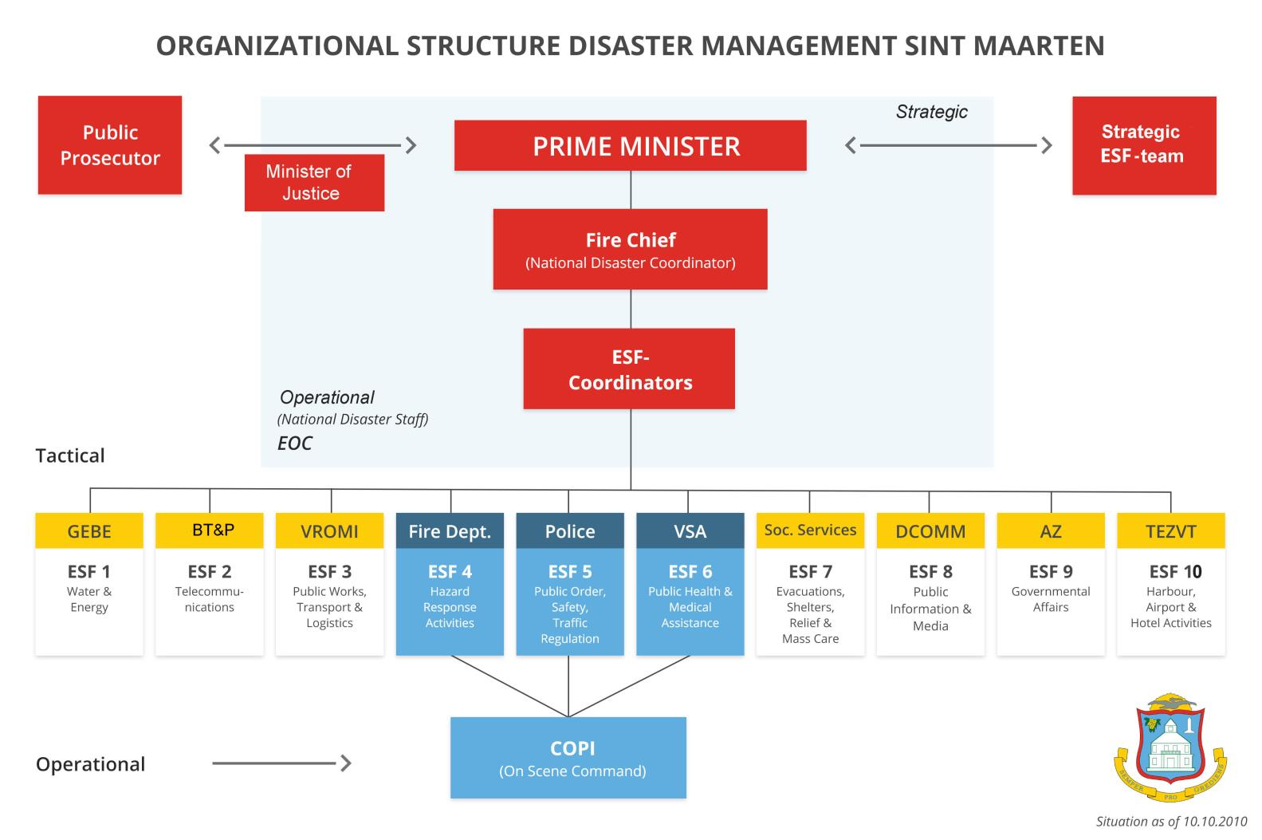

Slide 18
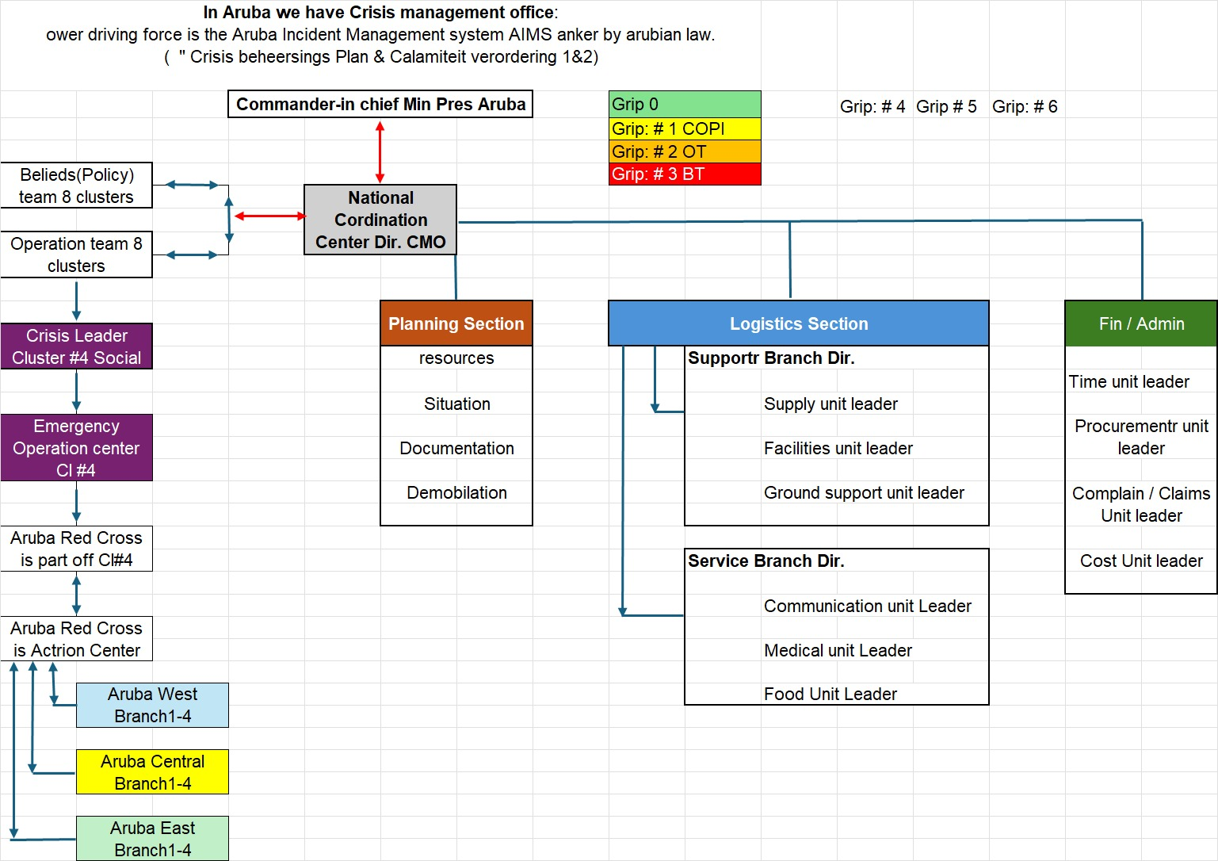
Aruba Disaster Management Structure

Slide 19
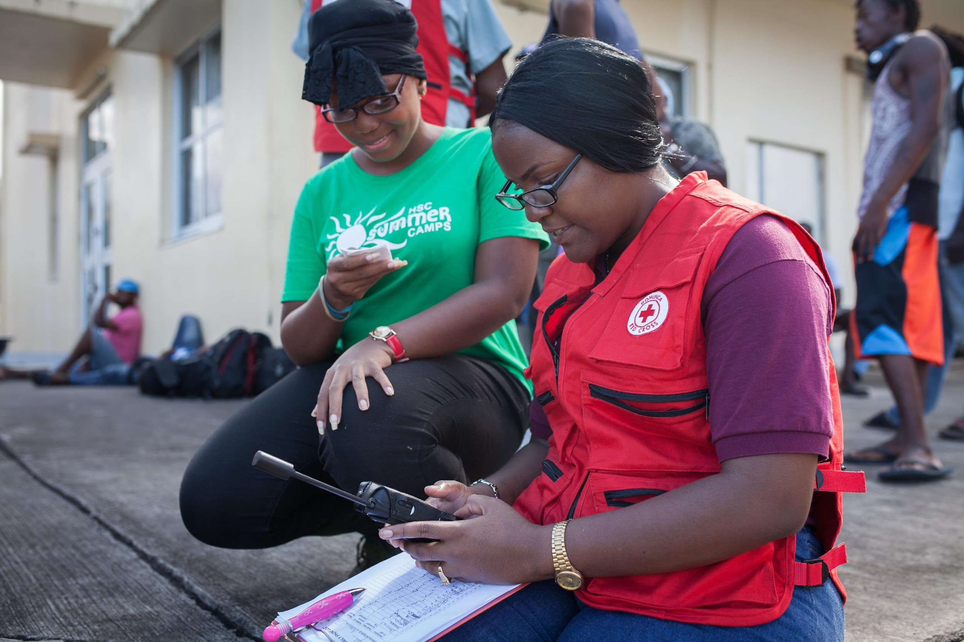
Command Staff
Public Information Officer
Safety Officer
Liaison Officer

Slide 20
Advise the Incident Commander on information dissemination and media relations.
Serve as the primary contact for anyone who wants information.
Serve external audience and internal audience.
Obtain information from the Planning Section.
Coordinate with other public information staff.
Obtain information from the community, the media, and others.
Responsibilities Of
The Public Information Officer

Slide 21
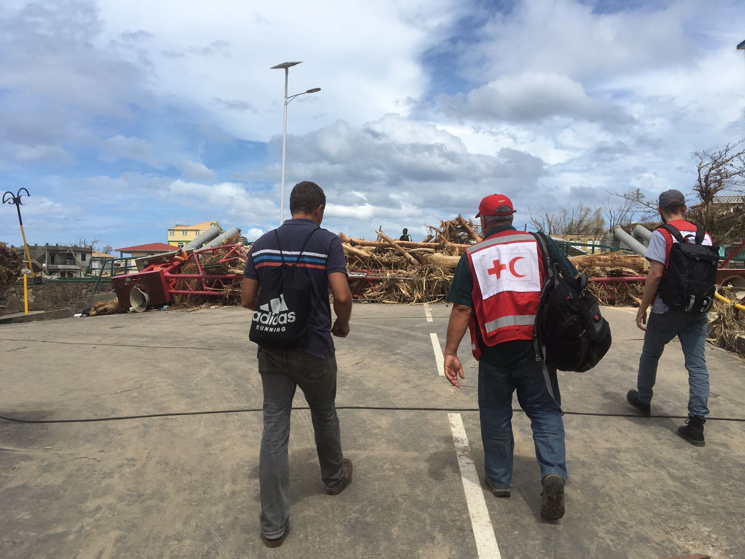
Ensures responder safety.
Advises Incident Command on safety issues.
Minimizes employee risk.
Responsibilities Of
The Safety Officer

Slide 22
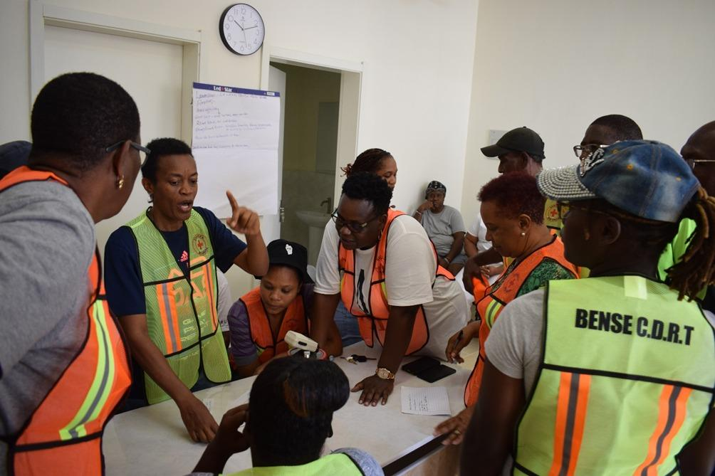
Gathers information about support agencies.
Coordinates for agencies not in command structure.
Provides briefings and answers questions.
Responsibilities Of
The Liaison Officer

Slide 23
Understanding The General Staff
Incident Command
Operations Section
Planning Section
Logistics Section
Finance/ Administration Section

Slide 24
ICS Section Chiefs And Deputies
Section Chief
Deputy
Deputy
Team Leader
Individual Resource

Slide 25
Operations Section Chief
Develop and manage the Operations Section.
Develops and implements strategies and tactics.
Work very closely with other members of the Command and General Staff to coordinate tactical activities.

Slide 26
Operations Section Expanding
Operations
Section Chief
Transportation Specialist
Engineering Specialist
Mass Care Specialist
Fire Strike
Team Leader

Slide 27
Gathers and analyzes information.
Gathers, analyzes, and disseminate intelligence and information.
Manages the planning process.
Compiles and develops the Incident Action Plan.
Manages the activities of Technical Specialists.
Works closely with the Incident Commander and General Staff.
Planning Section Chief Roles

Slide 28
What, Where, When, Who, How?
What do we want to do?
Where do we stage?
When are we going to do it?
Who is responsible for doing it?
How do we communicate with each other?
What is the procedure if someone is injured?
Incident Action Plan Elements

Slide 29
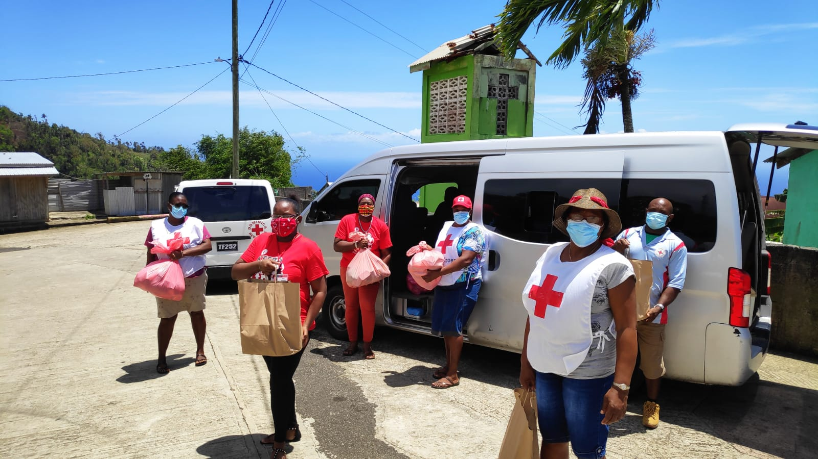
Provides resources and services to support the incident.
Develops portions of the IAP.
Contracts for goods and services.
Role Of The Logistics Section Chief: Role

Slide 30
The Role Of The Finance/ Administration Section Chief
Negotiate contracts.
Time keeping for personnel and equipment.
Documenting and processing claims.
Tracking costs.

Slide 31
The ability to communicate with ICS is critical.
Use standard, common terminology.
Avoid jargon.
Use standard ICS position titles and facility names.
Develop a communications plan and protocols specific to the incident.
Determine flow path for communications.
Communications With ICS

Slide 32
Observe strict radio/telephone procedures.
Use plain English in all communications.
Limit radio and telephone traffic to essential information only.
Follow procedures for secure communications as required.
Communications Discipline

Slide 33
Incident Command Post (ICP): Where the Incident Commander oversees the incident.
Staging Areas: Where resources are kept while waiting to be assigned.
Base: Where primary logistics functions are coordinated and administered.
Camps: Where resources may be kept.
Helibase/Helispot: The area from which helicopter operations are conducted.
Incident Facilities

Slide 34
Review assignment.
Establish a clear understanding of your decisionmaking authority.
Determine procedures for contacting your headquarters or home office (if necessary).
Handover protocol from the Red Cross to the Government.
Identify purchasing authority and procedures.
Determine how food and lodging will be provided.
Roles
And
Authorities

Slide 35
Ensure personnel accountability.
Track resources.
Prepare personnel for assignments and reassignments.
Locate personnel in case of an emergency.
Establish personnel time records and payroll.
Plan for releasing personnel.
Organize the demobilization process.
Check-In
At The Incident

Slide 36
Briefings received and given should include:
Situation assessment.
Specific job responsibilities.
Coworkers.
Work area.
Eating and sleeping arrangements.
Instructions for obtaining additional supplies, services, and personnel.
Operational periods/work shifts.
Required safety procedures and PPE.
Initial Incident Briefing

Slide 37
Print or type all entries.
Enter dates by month/day/year format.
Enter date and time on all forms and records. Use local time.
Fill in all blanks. Use N/A as appropriate.
Use military 24-hour time.
Section Chiefs and above should assign a log keeper (scribe).
Incident Recordkeeping

Slide 38
Complete work assignments.
Brief replacements, subordinates, and supervisor.
Follow check-out procedures.
Provide follow-up contact information.
Return incident-issued equipment.
Complete post-incident reports, critiques, evaluations, and medical follow-up.
Resolve payment and/or payroll issues.
Incident Demobilisation

Slide 39

Simulation Exercise Roles

Slide 40
Description: This person is in charge of leading and coordinating the response. This person is also responsible for sharing information (injects) with the rest of the team and assign the responibilities of other team members. This person must also keep the National Society updated on new developments and actions being taken by the team members.
Skills: Must have strong leadership, communication and decision-making skills. Must be able to work well under pressure. Must have strong technical knowledge of the CDRT materials and understand of what is required to coordinate a response.
CDRT Leader/ Incident Commander

Slide 41
Data Collectors
Description: These persons are tasked with conducting Damage Assessments and Needs Analysis (DANA) and identifying the type of assistance that is needed by community members. These persons must also keep the CDRT Leader/Incident Commander updated on immediate assistance needed in the field.
Skills: Must have strong leadership, communication and decision-making skills. Must be able to work well under pressure. Must have strong technical knowledge of the CDRT materials and understand of what is required to coordinate a response.

Slide 42
Data Collectors
Description: These persons are tasked with conducting Damage Assessments and Needs Analysis (DANA) and identifying the type of assistance that is needed by community members. These persons must also keep the CDRT Leader/Incident Commander updated on immediate assistance needed in the field.
Skills: Must have strong leadership, communication and decision-making skills. Must be able to work well under pressure. Must have strong technical knowledge of the CDRT materials and understand of what is required to coordinate a response.

Slide 43
Safety Personnel
Description: This person is in charge of assessing the safety levels of new developments and advising the CDRT Leader/Incident Commander is it is safe to dispatch team members in the field. This person will assist the CDRT leader/Incident Commander with coordinating medical support.
Skills: Must be first aid trained and have good leadership, communication and coordination skills. Must be adaptable and have strong decision-making skills.

Slide 44
Description: This person is in charger of communicating with communities and should lead the community assessments being conducted. This person is charged with ensuring that teams dispatched in the field keep the CDRT Leader/Incident Commander updated on developments and activities being taken.
Skills: Must have strong verbal and non-verbal communication skills. Must have some stronger leadership skills and experience with collecting data. Must be adaptable and have strong decision-making skills.
Community Liaison Personnel

Slide 45
Shelter Manager
Description: This person is in charge of opening and leading the team that sets up and manages the shelter. This person must keep the CDRT Leader/Incident Commander of any developments and assistance needed at the shelter.
Skills: Must have strong technical knowledge of shelter management and setting up a shelter. Must have strong leadership, coordination and decision-making skills.

Slide 46
Shelter Personnel
Description: This person assist the shelter manager with setting up and managing the shelter and liaising with the shelterees.
Skills: Must have a good understanding of shelter management. Must have good communication skills and be adaptable.

Slide 47
First Aid Medical Team
Description: These persons are tasked with treating injured persons in the field and keeping the Safety Personnel informed of new developments and field activities, including the number of persons injured and treated).
Skills: Must be first aid trained and have strong technical knowledge of identifying and treating various injuries. Must be knowledgeable about safely moving victims from one place to another.

Slide 48





Volunteer, Donate, Join Us In Partnership, or share our appeals and stories on social media. Find out more about IFRC and learn how to contact your National Red Cross or Red Crescent Society, at www.ifrc.org.
Get Involved
There are many ways of becoming a part of the world’s largest humanitarian network
To stay informed about Caribbean disaster response activities or to access additional information on available trainings, training materials, research and information management tools, visit: www.cadrim.org.
: CADRIM.IFRC
: @cadrim_ifrc
: @CADRIM_IFRC

