Slide 1
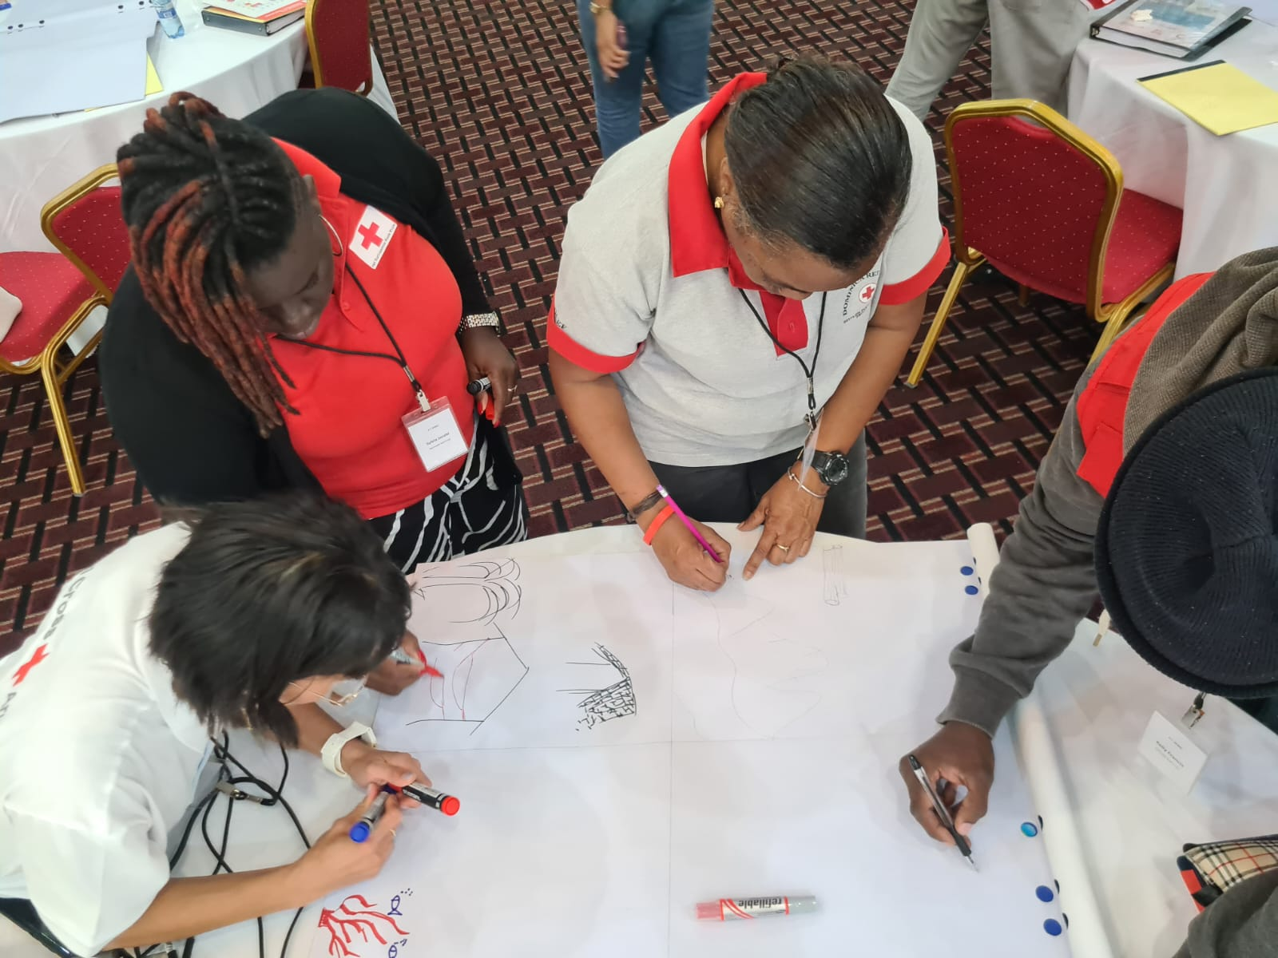

Adult Learning & Leadership in Disaster Response Training
June 2025

Slide 2
Purpose
Build on what you already know by exploring tips to improve your learning. Focusing on teamwork, communication, and working with different personalities. You’ll also learn how to share this knowledge with Red Cross colleagues and community members involved in disaster response.
Notes:
Building Effective Teamwork in Community Training
Importance of collaboration in disaster education
Strategies to foster trust, cooperation, and shared responsibility
Understanding Team Dynamics and Personality Types
Recognizing different personality types and communication styles
Adapting your facilitation approach to maximize engagement and inclusion
Facilitation Best Practices for Diverse Community Groups
Tailoring methods for specific audiences:
Elderly participants: addressing physical, cognitive, and emotional considerations
Low-literacy learners: using visual aids, storytelling, and interactive techniques
Young adults (18–25): leveraging peer learning, hands-on activities, and real-life relevance
Using Technology to Enhance Learning
Online facilitation: tools, platforms, and strategies for virtual engagement
In-person facilitation: blending tech with traditional methods to boost interaction
Ensuring accessibility and digital inclusion for all learner types

Slide 3
Understand how to build effective teamwork and adapt to different personality types in disaster response training.
By the end of this session, you will:
Learn how to communicate and work with different community groups, including the elderly, low-literacy learners, and young adults.
Explore simple ways to use technology to communication before, during and after a disaster with different community groups.
Notes:
Building Effective Teamwork in Community Training
Importance of collaboration in disaster education
Strategies to foster trust, cooperation, and shared responsibility
Understanding Team Dynamics and Personality Types
Recognizing different personality types and communication styles
Adapting your facilitation approach to maximize engagement and inclusion
Facilitation Best Practices for Diverse Community Groups
Tailoring methods for specific audiences:
Elderly participants: addressing physical, cognitive, and emotional considerations
Low-literacy learners: using visual aids, storytelling, and interactive techniques
Young adults (18–25): leveraging peer learning, hands-on activities, and real-life relevance
Using Technology to Enhance Learning
Online facilitation: tools, platforms, and strategies for virtual engagement
In-person facilitation: blending tech with traditional methods to boost interaction
Ensuring accessibility and digital inclusion for all learner types

Slide 4
Start with a clear team briefing.
Building Effective Teamwork in Disaster Response Training
Assign roles based on strength not availability.
Use a buddy system for pairing more experienced team members with less experienced ones.
If personalities clash, pause and reassign tasks
Practice inclusive communication within the team.
Empower different team members to lead.
Debrief.
Notes:
Roles: Let everyone try different roles over time. This builds confidence and team resilience.
Communication: Hold a quick check-in before and after each session.
“What’s our game plan?”
“Anything that went wrong last time we should fix?”
“How are you feeling about your role today?”
Debrief after each session:
Review what worked
Talk about what could improve (without blame)
Appreciate individual contributions

Slide 5
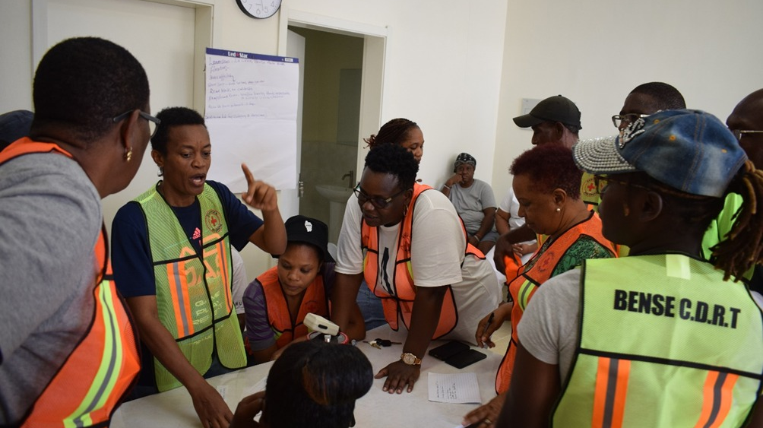
Understanding
Team Dynamics & Personality Types

Slide 6
The Over-Participant
Very excited, often dominating discussions or activities with lots of contributions.
The Challenger
Questions ideas, opinions, and approaches, often playing devil's advocate to stimulate critical thinking.
The Expert
Knows a lot about the topic. Often providing valuable insights and guidance.

Slide 7
The Distracted
Struggles to stay focused, easily loses interest during trainings, discussions or activities.
The Sleepy
Appears drowsy or disengaged, often struggling to stay awake during trainings or activities.
The Rookie
New to the group or topic, lacking experience or knowledge about the topic being discussed.

Slide 8
The Unpunctual
Frequently arrives late to trainings or activities, disrupting schedules.
The Wolf
Tends to dominate discussions aggressively, disregarding others' opinions or views.
The Ally
Actively supports and encourages others within the group.

Slide 9
You will be placed in an assigned group and breakout room.
Each group has 10 minutes to talk about how to work with 3 different personality types.
For example, “The Driver” is someone who works fast and gets things done quickly. The team should suggest that they time keep and letting them take the lead on tasks that need quick action.
Choose 1 person to share what your group talked about.
Your group will have 3 minutes to give your feedback to everyone.
Activity:
How to work
with different
Personalities

Slide 10
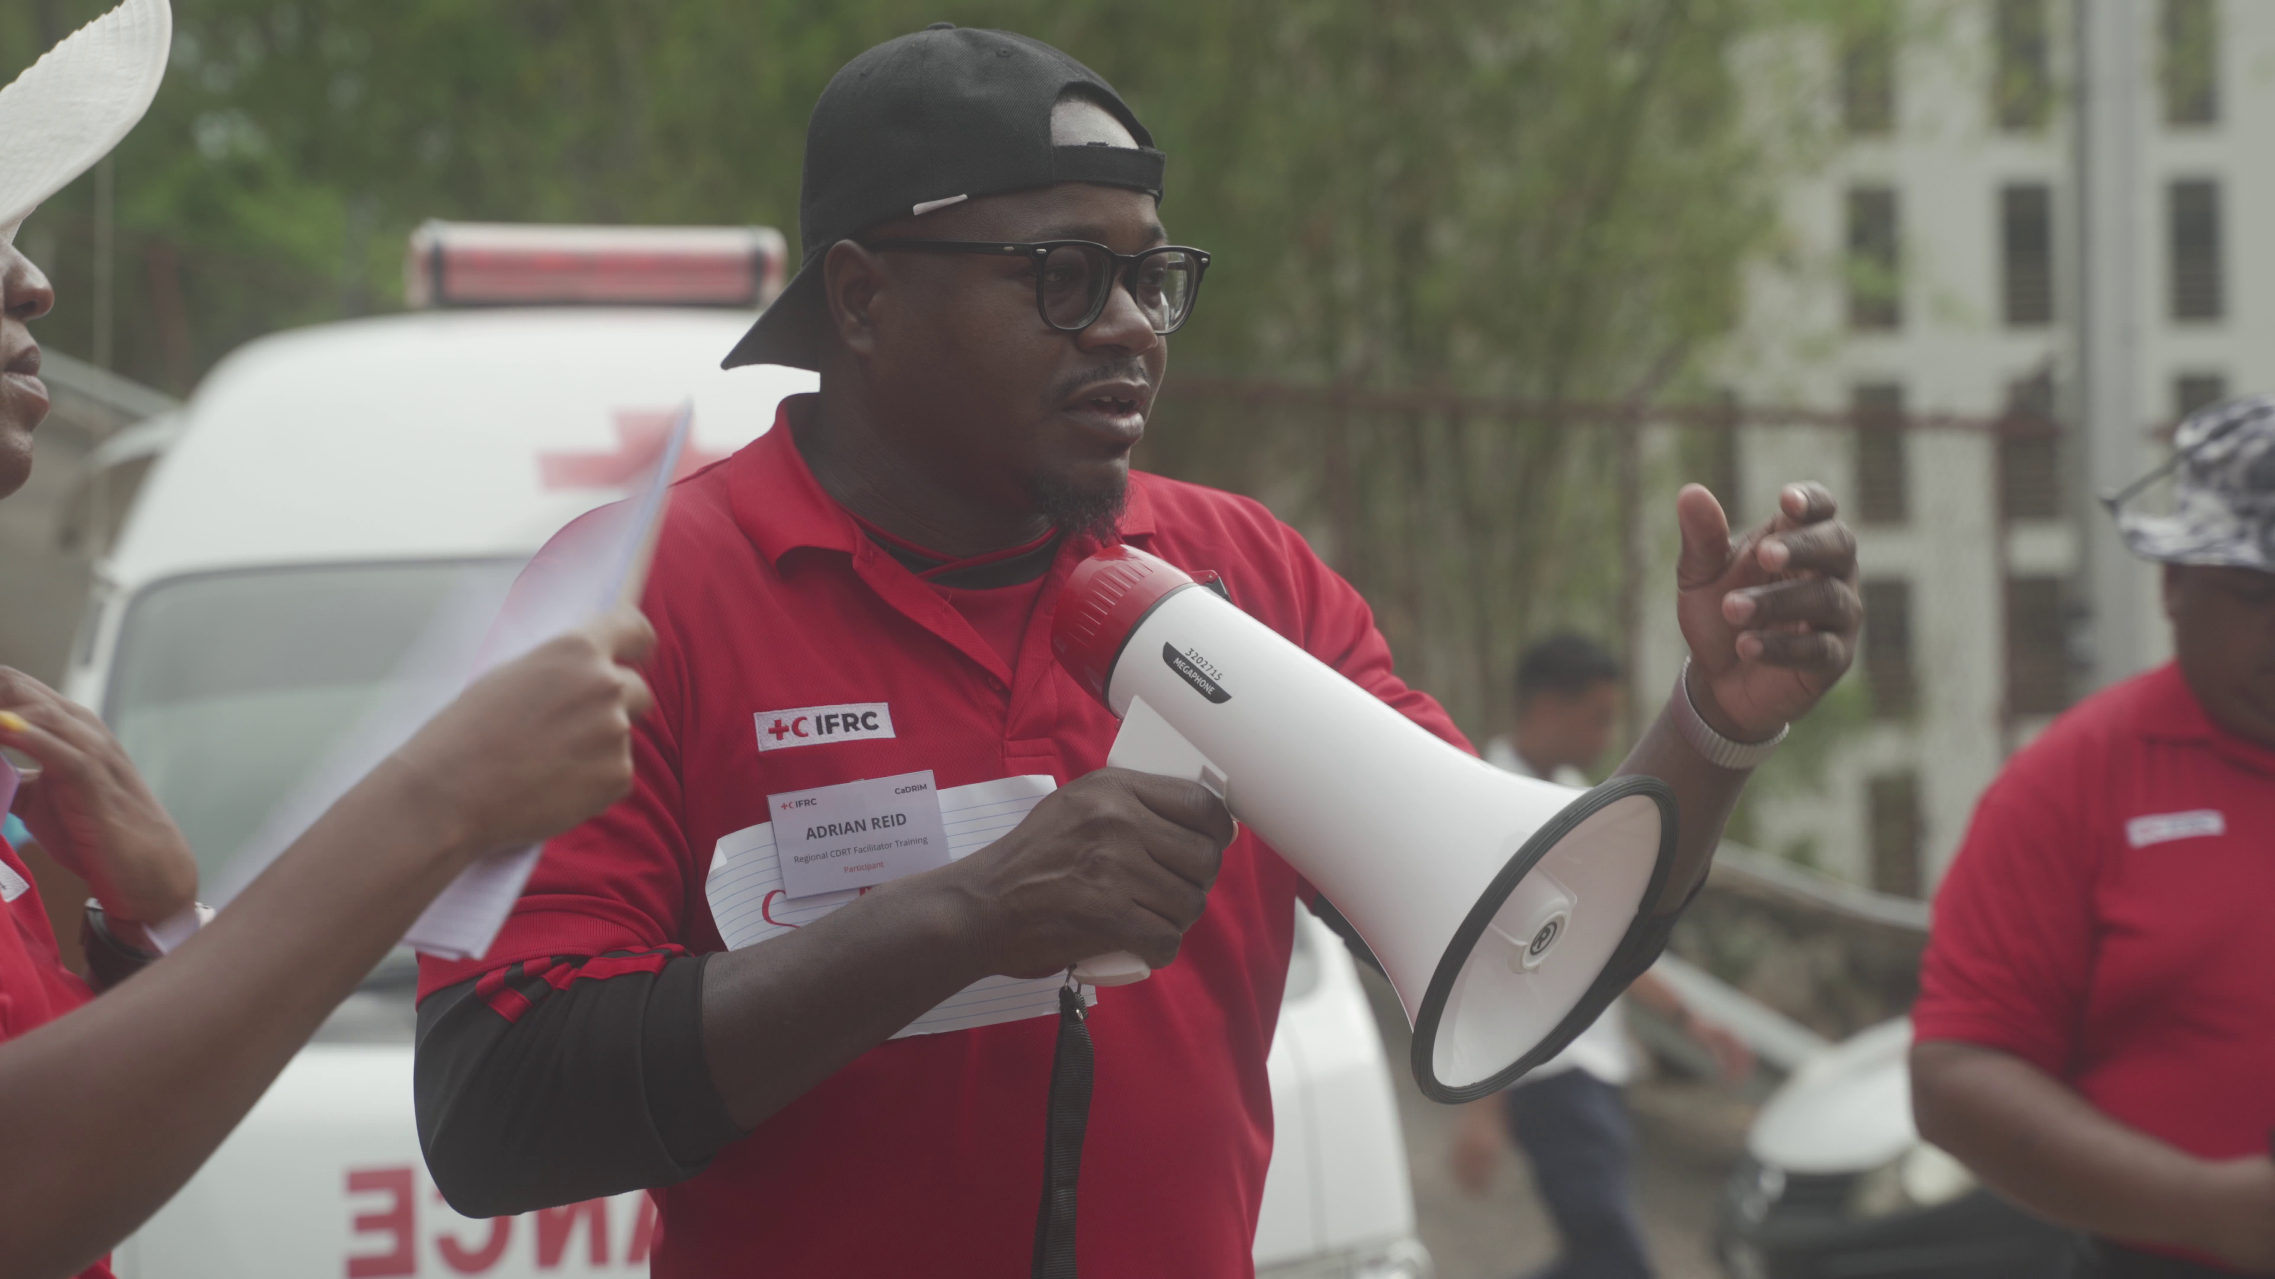
What makes a good
Leader

Slide 11
Actions
Listens to Others
Ask Questions
Takes Responsibility
Shares What They Learned
Practices New Skills
Helps the Team
Stays Positive
Actions of
Effective
Leadership
in
Training
Notes:
Clear Vision and Direction: Effective leaders provide a clear vision and direction for the training program. They outline specific goals and objectives, ensuring that participants understand the purpose and expected outcomes of the training. This clarity helps to focus the facilitation process, ensuring that activities and discussions are aligned with the overall objectives of the training.
Motivation and Engagement: Leaders inspire and motivate participants to actively engage in the learning process. By fostering a positive and supportive environment, they encourage participants to take ownership of their learning and invest their time and energy in acquiring new knowledge and skills. Effective leaders use motivational techniques such as storytelling, encouragement, and recognition to keep participants engaged and committed to the training.
Facilitation of Interactive Learning: Leaders facilitate interactive learning experiences that promote active participation and collaboration among participants. They employ a variety of facilitation techniques, such as group discussions, case studies, role-playing exercises, and hands-on activities, to create opportunities for experiential learning and knowledge sharing. Through dynamic facilitation, leaders stimulate critical thinking, problem-solving, and skill development among participants.
Empowerment and Skill Development: Effective leaders empower participants by providing opportunities for skill development and growth. They create a supportive learning environment where participants feel confident to explore new ideas, experiment with new skills, and learn from their mistakes. Leaders encourage participants to take on leadership roles within the training program, fostering a sense of ownership and responsibility for their own learning and development.
Adaptability and Flexibility: Leaders demonstrate adaptability and flexibility in responding to the evolving needs and dynamics of the training environment. They are able to adjust their facilitation approach in real-time, based on feedback from participants, changes in the training agenda, or unexpected challenges that arise during the training. By remaining responsive and flexible, leaders ensure that the facilitation process remains effective and relevant to the needs of the participants.
Modeling Effective Leadership Behaviors: Leaders lead by example, modeling effective leadership behaviors for participants to emulate. They demonstrate qualities such as communication skills, active listening, empathy, and resilience, which are essential for effective leadership in disaster response situations. By observing these behaviors in action, participants are inspired to develop their own leadership abilities and apply them in their roles as community disaster responders.
Overall, effective leadership enhances the facilitation process and fosters learning within community disaster response training by providing clear direction, motivating and engaging participants, facilitating interactive learning experiences, empowering participants, demonstrating adaptability, and modeling effective leadership behaviors. By embodying these principles of leadership, facilitators can create a dynamic and impactful training environment that prepares participants to effectively respond to disasters and contribute to the resilience of their communities.

Slide 12
Builds Strong Leaders
Training helps people become confident and capable leaders.
Leaders know what to do and how to guide others.
Prepares Communities for Crisis
In a disaster, trained leaders stay calm and take action.
They help others know what to do, where to go, and how to stay safe.
Promotes Teamwork and Trust
Leadership training teaches how to work well with others.
When people trust their leaders, they follow faster and feel safer.
Encourages Fast, Smart Decisions
In emergencies, quick thinking is important.
Training teaches leaders how to decide quickly and wisely.
Why
Leadership
in
Training
is Important

Slide 13
Empowers Others to Lead
Leadership training is not just for one person.
It helps everyone feel strong and ready to help in the future.
Creates a Culture of Preparedness
A trained leader talks about planning, safety, and working together.
This helps the whole community get ready before a disaster happens.
Saves Lives
With strong leaders and good planning, more people survive and recover.
Leadership in training is not just helpful—it is life-saving.
Why
Leadership
in
Training
is Important

Slide 14
Activity:
Encouraging Leadership amongst different Personality Types
You will be placed in an assigned group and breakout room.
Your group has 10 minutes to talk about how to encourage certain personality types to take a leadership role.
Choose 1 person to share what your group talked about.
Your group will have 3 minutes to give your feedback to everyone.

Slide 15
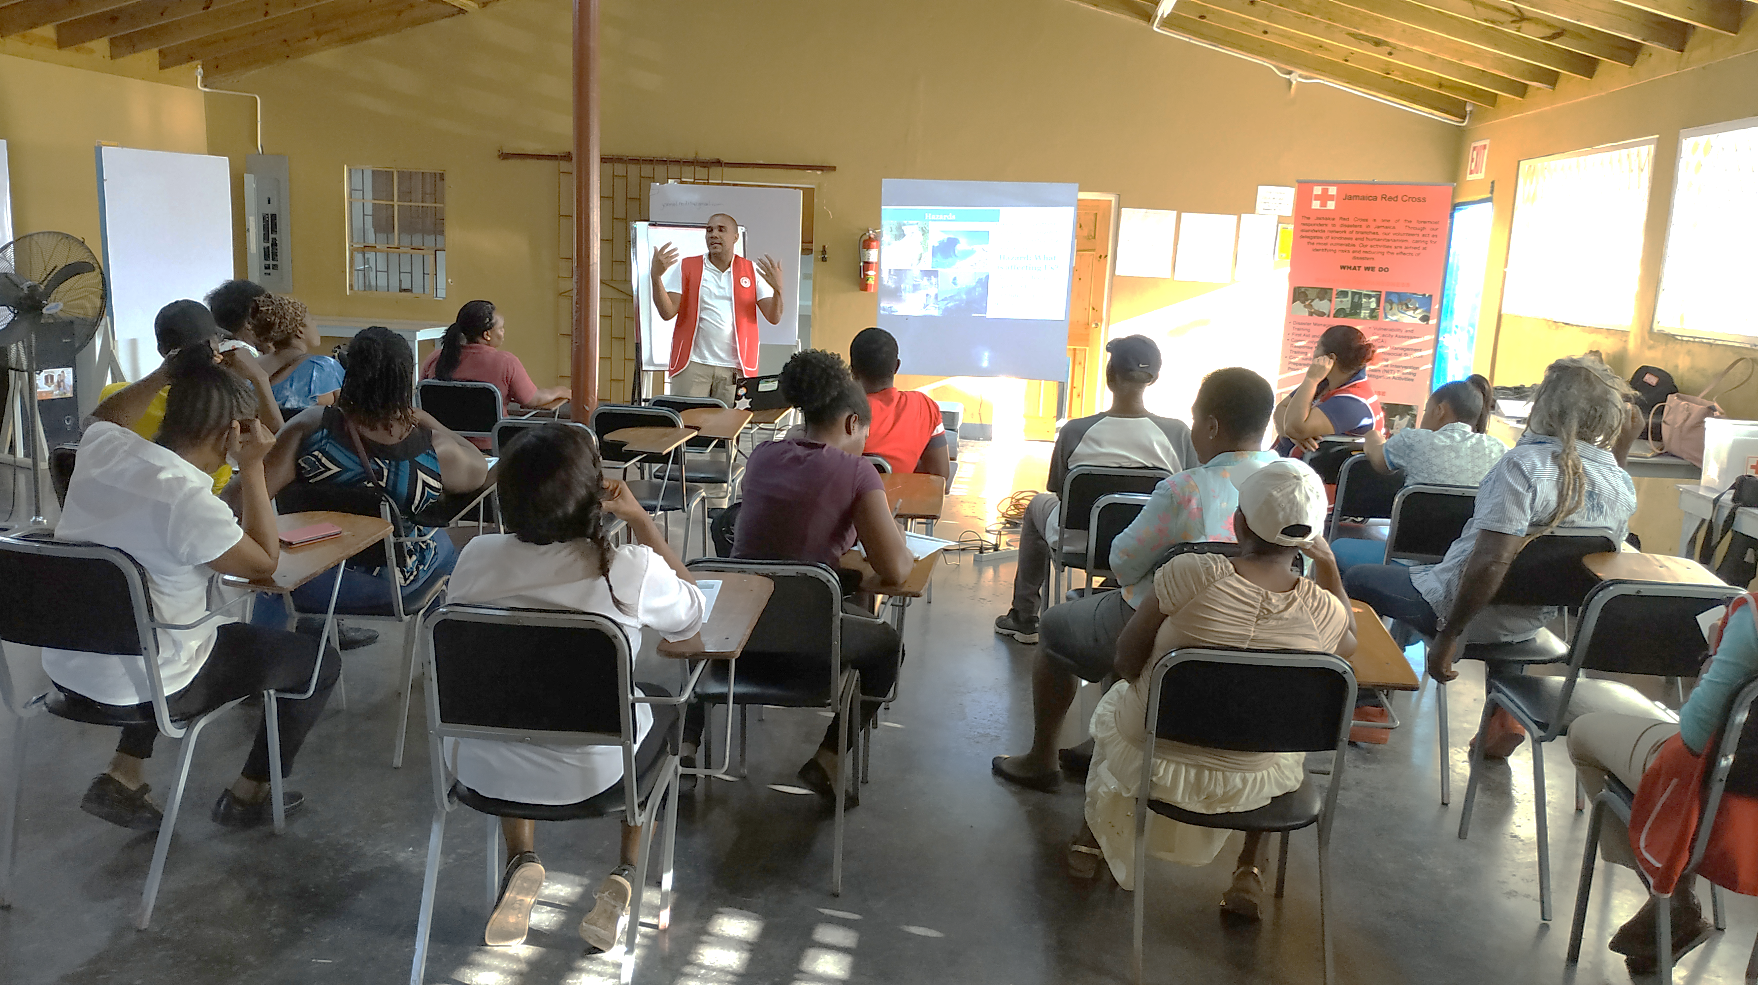
Communicating and Working with
Different Community Groups

Slide 16
The objective is to do what is IN and avoid what is OUT
IN
In the chat identify skills you think makes a good (or effective) communicator.
Activity:
Communication
Do’s
and
Don’ts
OUT
In the chat identify actions you think makes a bad (or ineffective) communicator.

Slide 17

Active Listener
Skills
of an
Effective
Communicator
Feedback Skills
Non-Verbal Communication
Confidence & Staying Calm
Open
Mindedness
Adjust to changes easily
Notes:
Time Management: Effective facilitators adeptly organize and allocate time during sessions, prioritizing topics and setting realistic schedules to maximize productivity and engagement. By managing time effectively, they optimize learning opportunities while respecting participants' commitments.
Preparedness: Prepared facilitators meticulously plan and prepare for sessions, ensuring relevant content, available resources, and logistical readiness. They anticipate challenges, equipping themselves to address diverse needs and unexpected situations, instilling confidence and trust among participants.
Clear Communication: Facilitators skilled in clear communication articulate ideas concisely, fostering comprehension through active listening and effective questioning. Their communication promotes open dialogue and mutual understanding, laying a foundation for meaningful collaboration.
Objective Viewpoint: Facilitators maintain neutrality, allowing diverse perspectives to be heard and respected. They encourage critical thinking, fostering an environment of fairness and open-mindedness that enhances learning outcomes. The ability to see things objectively means you can change your perspective, stay composed and make more informed decisions that capture the essence of the problem at hand. Put simply, an effective facilitator aims to bring out the best in others.
Positive Culture Champion: Positive culture champions cultivate inclusive environments, modeling behaviors that inspire confidence and trust. Through encouragement and recognition, they nurture optimism and resilience, empowering individuals to thrive.
Adaptability: Adaptable facilitators respond flexibly to evolving needs, adjusting approaches based on feedback and unforeseen circumstances. Their resourcefulness ensures sessions remain relevant and impactful, even in challenging situations.
https://acorn.works/resources/facilitator-roles-and-skills

Slide 18
Best Practices
Tools & Techniques
Communicating
with the
Elderly
Use slower, clearer speech with simple language.
Avoid technical jargon; use everyday examples (e.g., “your medication bag” instead of “emergency health kit”).
Repeat key points and check for understanding often.
Use voice notes, visual aids, and hands-on demonstrations.
Provide printed materials in large fonts with images.
Assign a “Tech Buddy” (e.g., a youth volunteer) to assist with devices if needed.

Slide 19
Best Practices
Tools & Techniques
Communicating
with the
Low Literacy
Use visual storytelling and oral communication.
Avoid written instructions — use demonstrations, videos, or role-play.
Ask questions verbally and encourage discussion.
Use videos in local dialect with no/limited text (e.g., WhatsApp videos).
Incorporate props. For e.g., an actual go-bag and let people touch, hold, and ask questions about each item. Say: ‘This is a flashlight. When would we use it
Use group work to build comfort and peer support.

Slide 20
Best Practices
Tools & Techniques
Communicating
with the
Young Adults
Keep content interactive and fast-paced.
Use peer-to-peer learning, tech tools, and challenges.
Link training to real-life scenarios (job skills, protecting family, etc.).
Use Kahoot, TikTok challenges, or scenario-based group tasks. For e.g., ask groups to create a 60-second video on how to secure a house before a storm.
Incorporate mobile-friendly quizzes, short videos, and QR codes.
Give leadership roles to young people (e.g., leading a group discussion).

Slide 21
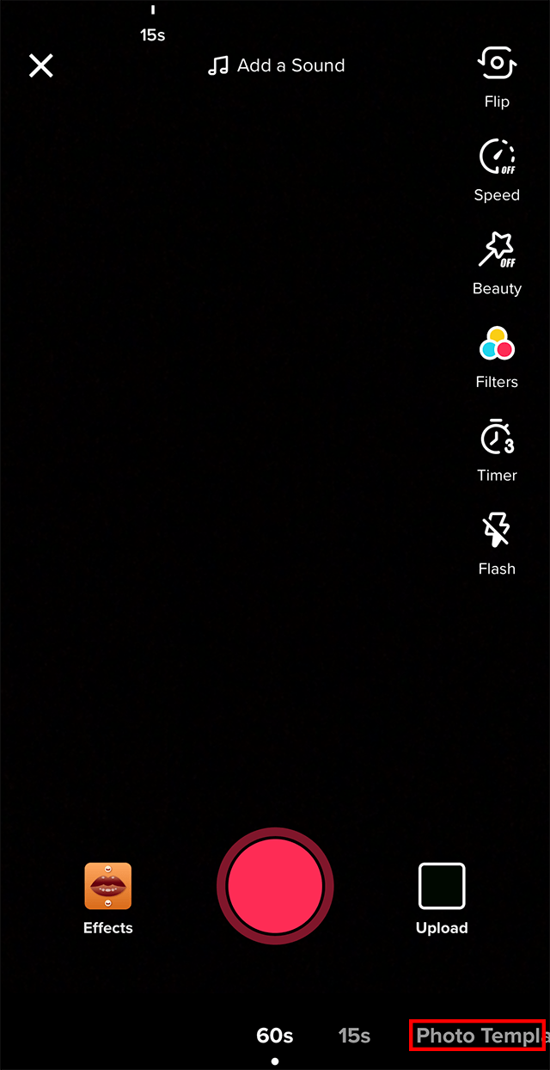
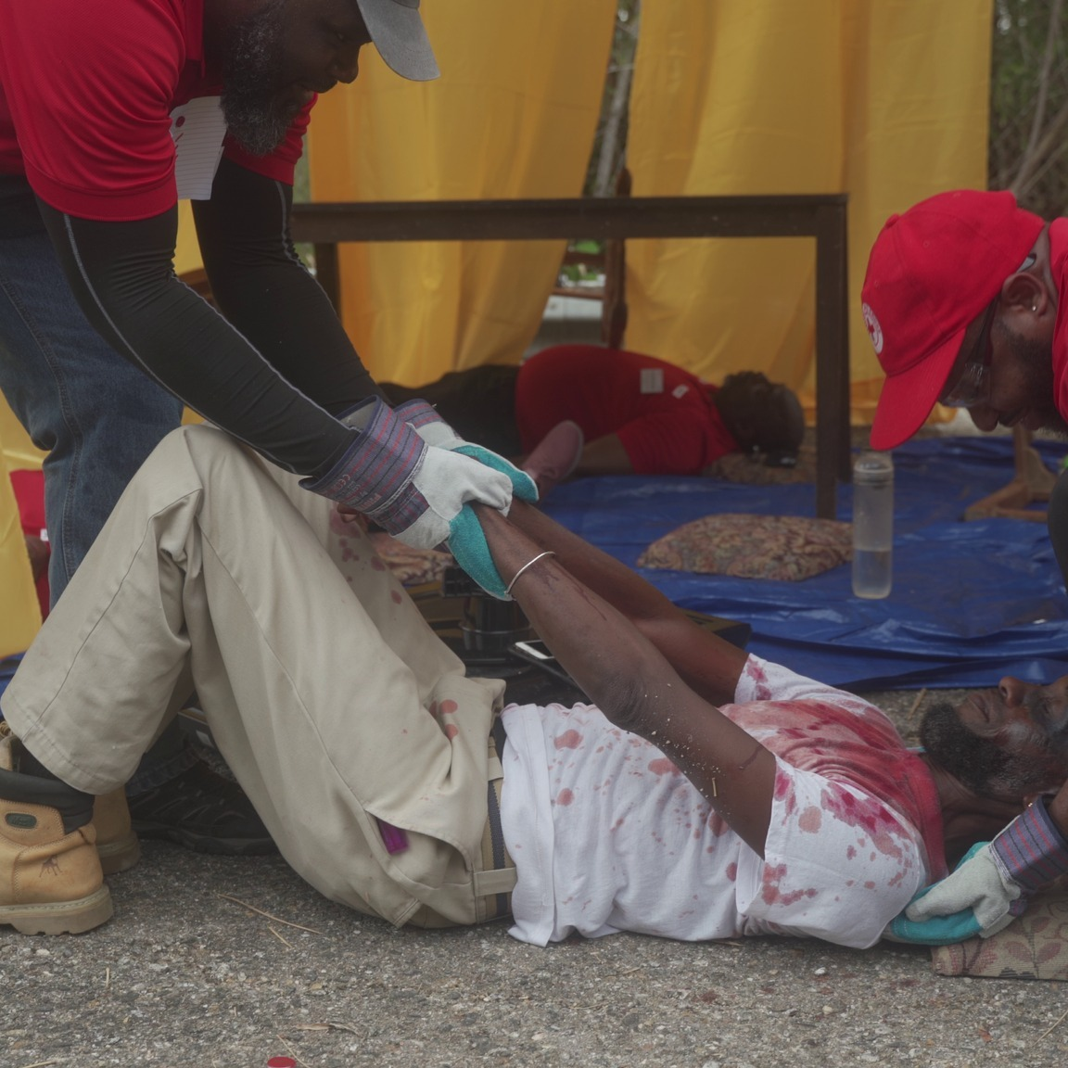
Using Technology
to
Communicate
before, during and after a disaster.

Slide 22
How They Can Use Tech:
Elderly
Participants
Teach Elders to Use WhatsApp for Emergencies
Show them how to send their location or a voice note to family if they’re in danger.
Train "Digital Buddies“
Pair each elder with a younger family or community member who helps with tech (explained more below under “Tips for Everyone”).
Alternatively,
Challenges:
CDRTs can prepare and send short, clear voice notes explaining disaster steps. For e.g., “Put your ID and meds in a waterproof bag. Keep it near your door.”
May not be tech-savvy, may have vision/hearing impairments, might not use smartphones often.

Slide 23
Low Literacy
Participants
Short Disaster Response and Preparedness Videos in Local Dialect with pictures or actions but no text to describe examples or scenarios.
Creation of a CDRT WhatsApp group to share voice messages or videos
Challenges:
Struggle with reading; need visual, hands-on, or oral formats.
Creation of a CDRT YouTube Channel. Use QR code posters to direct participants to the YouTube videos and voice messages.

Slide 24
Young Adults
Participants
Gamified Mobile Friendly tools such as Google Forms, Quizzes Mentimeter, Quizizz or Booklet to create quizzes and polls.
https://www.mentimeter.com/blog/education/kahoot-alternatives
Challenges:
Create & Share Disaster Preparation and Response messages using Prep TikTok or Instagram Reels
Distracted easily, but tech-savvy. Want engaging, quick, and social content.
Challenge them to create a short video showing how to pack a go-bag or secure a roof. Use hashtags like #CaribbeanReady or #StormSafeChallenge to spread awareness and create engagement.

Slide 25
Closing Remarks
Tracey Werelman

Slide 26





Volunteer, Donate, Join Us In Partnership, or share our appeals and stories on social media. Find out more about IFRC and learn how to contact your National Red Cross or Red Crescent Society, at www.ifrc.org.
Get Involved
There are many ways of becoming a part of the world’s largest humanitarian network
To stay informed about Caribbean disaster response activities or to access additional information on available trainings, training materials, research and information management tools, visit: www.cadrim.org.
: CADRIM.IFRC
: @cadrim_ifrc
: @CADRIM_IFRC

