Slide 1
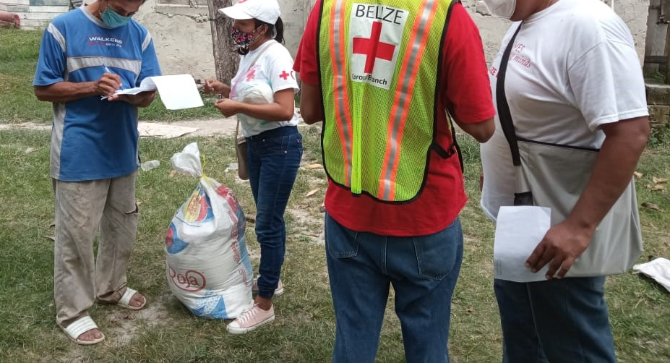

CDRTs & Community Assessment
For Community Disaster Response Teams

Slide 2





Acknowledgements
We thank the Red Cross Aruba, Barbados Red Cross, Guyana Red Cross, Netherlands Red Cross Red Cross, and the Sint Maarten Red Cross for their commitment to collaborating with the Caribbean Disaster Risk Management (CaDRiM) Reference Centre. Together, we reviewed and revised the CDRT Training Material, enhancing its relevance and effectiveness in disaster response training. Your dedication exemplifies the spirit of cooperation within the humanitarian
community, and we deeply appreciate your invaluable contributions.

Slide 3

Objectives
To define an assessment
The purpose of Assessments
Assessments: Before, During and After
To explain how to do an assessment
To define the key principles and things to avoid

Slide 4
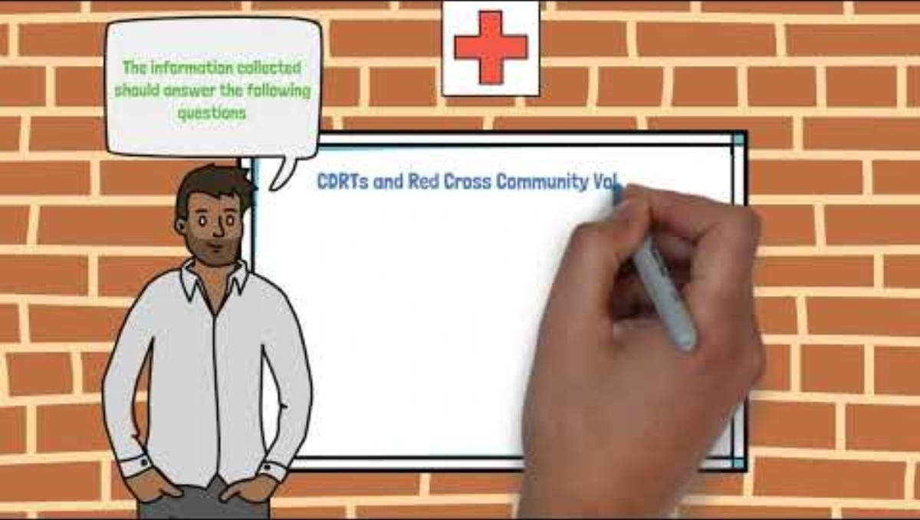
CDRT And Assessments
Notes:
assessments need to take into account CEA and protection considerations, some examples of questions:
1. What are the risks in the community people might need warned about? [info needs]
2. Where do people get information about the weather? What channels of communication are popular in the community?
3. How does the community agree on joint actions? When do people work?
4. Are vulnerable groups listened to? Can they participate? What is their location in the community?

Slide 5
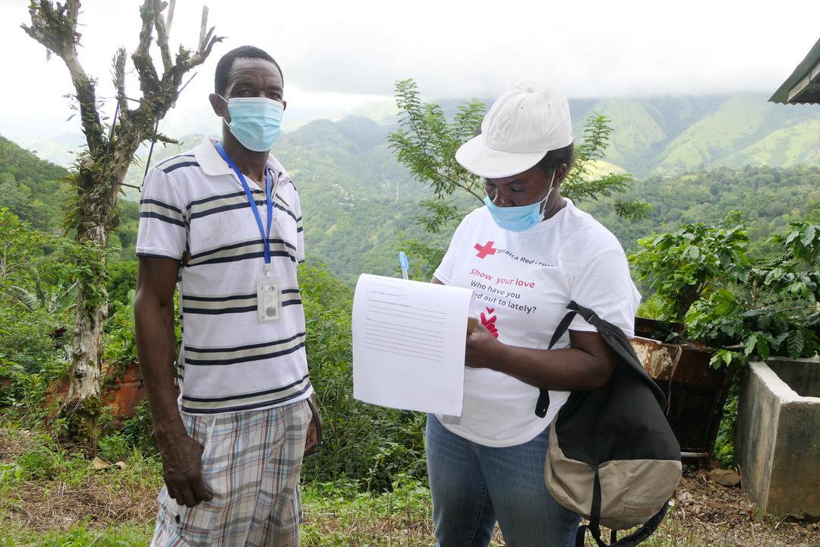
What Is An
Assessment?
Assessment speaks to the collection and analysis of data and the reporting of information collected.
Assessment can be done before and after a disaster.
Notes:
assessments need to take into account CEA and protection considerations, some examples of questions:
1. What are the risks in the community people might need warned about? [info needs]
2. Where do people get information about the weather? What channels of communication are popular in the community?
3. How does the community agree on joint actions? When do people work?
4. Are vulnerable groups listened to? Can they participate? What is their location in the community?

Slide 6
Purpose Of
Assessments
As a CDRT your first reason for carrying out an assessment may be to determine how your team will respond or assist the community.
Secondly your assessment will help provide information to the emergency organisations. Damage assessment and needs analysis ultimately assist emergency agencies in decision making and provide fast relief to affected persons.
Assists agencies in determining the extent of an event or a disaster.

Slide 7
Types Of
Assessments
Community Mapping
(DANA) Damage and needs analysis
Rapid Assessments (24 hrs)
Detailed assessments
Ongoing Community Monitoring and Surveillance
Key Areas To Cover When Doing Assessments
Health and Psychosocial Support
Water and Sanitation
Shelter
Livelihood, economic and infrastructural damage, including damage to the physical environment
Notes:
Be sure to mention the DANA is also used by the Government in most countries and used by secondary response agencies such as Ministries of Social Welfare, Ministries of Health and Ministries of Housing for example.
Persons with special needs should also be considered while assessments are conducted.the assessments need to have a brief, concrete but NEEDED protection, gender and inclusion section. Two things to assess: protection issues present in the community ( sexual gender based violence, violence against children...) and who are the vulnerable groups present. This is an ethical commitment and a humanitarian requirement.

Slide 8
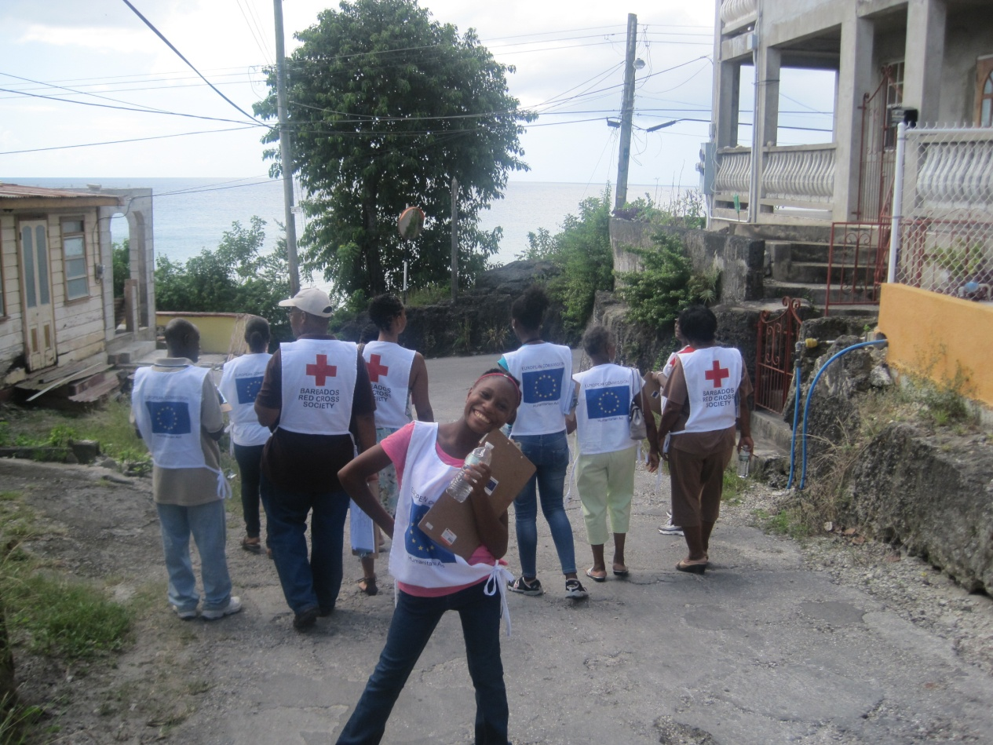
If There Is No
Disaster Why Do An
Assessment?

Slide 9
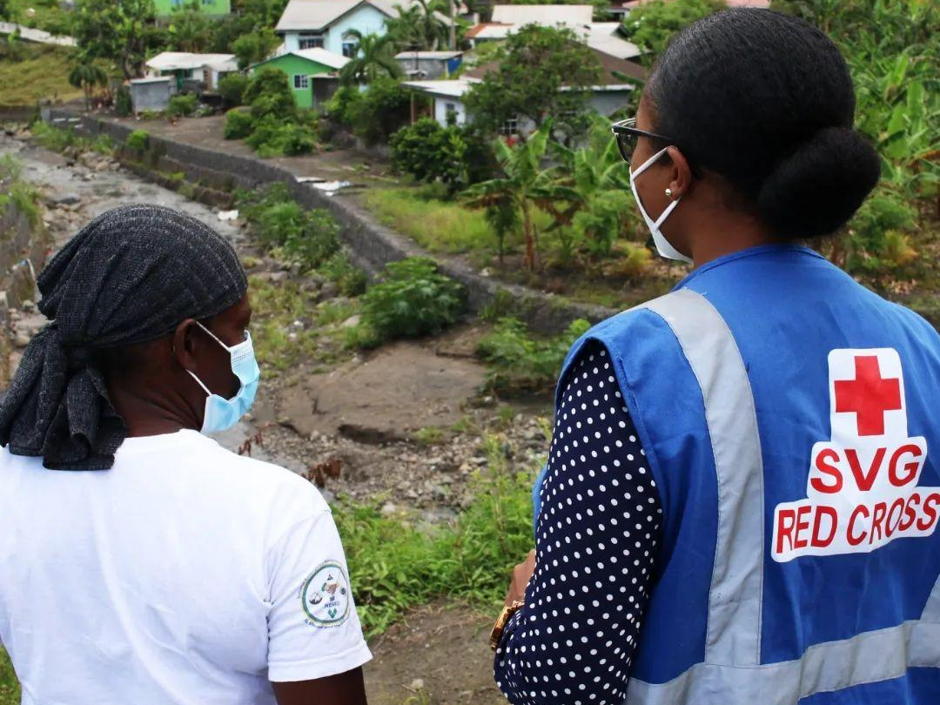
Assessments Done Before A Disaster Allows You To:
Determine how familiar you are with information to be collected.
Identify gaps and capacities.
Plan according to resources available in the community.
Notes:
Mention examples from a recent event of the community, if there is none a flooding event scenario can be used and describe knowing who is vulnerable such as older persons and disabled. Knowing their location what their needs are before flooding occurs and what there needs may be before the event happens.
Consider how useful this information can be to other agencies in terms of providing assistance.
Relating this to eVCA is also a good practice if the community has one or needs to conduct one.
Highlight when in the DRM Process are the various types or assessments used. eg. VCA is used in pre and DANA in post
VCA could be used post impact as well
Consider vulnerable groups ( gender i.e. women, men, boys and girls, LBGTW, environmental impacts, ecological, infrastructural and human needs) and how they may be impacted differently.

Slide 10
Consider the types of hazards that impacted your community in the past.
Identify the type of information that you can collect to help your Community Response Team to become better prepared and better able to respond before another hazard impact or disaster.
Identify who will collect the needed information.
Identify from where you will get this information.
Activity:
Collecting Information Before a Disaster
Note: You can also reference Unit 4 on page 12 of the CDRT Workbook

Slide 11





Assessment Done Before A Disaster
Planning
Practice
Better Response & Faster Recovery
There is much that can be done where assessments are concerned prior to impact. Now is the best time to do your community mapping. (Disaster Plans, Evacuation, Early Warning Systems)
Learn all you can about your community and anticipate the needs that you might have to response to in an emergency.
Notes:
Being prepared is best. As you would have learned before the best time to prepare is before disaster strike.

Slide 12

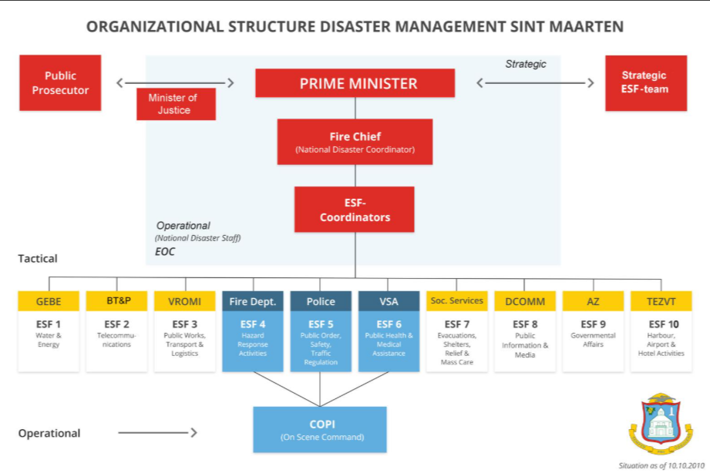
Get to know the other players, agencies and disaster personnel, get an understanding of what their information needs will be in an emergency
Role of
CDRT Before
Notes:
Under Point 1, some of the agencies that Aruba works with is the Crisis Management Office and ESF 6 and 7. The facilitator can ask the participants to identify some of the agencies their branches work with. Example of agencies that the Sint Maarten Red Cros works with can be seen in the image as it shows the organizational Disaster Management structure in Sint Maarten

Slide 13

Role of
CDRT Before
Develop your assessment strategy for your community. Work out different sampling methods, different methods of data collection etc
Get familiar with the forms you will use and develop forms where needed
Train your team and practice, make sure you know what you will do and who will be responsible for what areas and task.

Slide 14
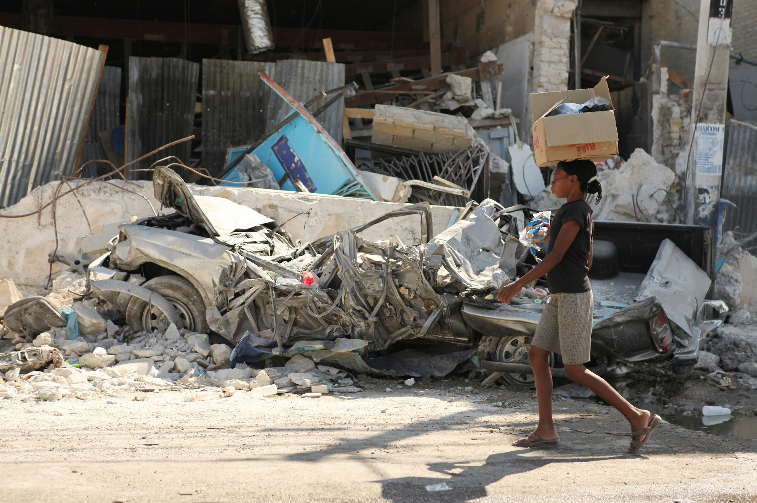
A Disaster
Has Happened, Now What?

Slide 15
What Type Of Information Is
Collected After
A Disaster?
What Happened?
  Gather the details of the emergency
Who/What was affected and how?
  Demographics of the affected, number and conditions?
Who’s On The Scene?
What are they doing, where are the gaps?
What Is Needed?
  Identify stakeholders or partners that can assist.

Slide 16

What Is
A Damage Assessment & Needs Analysis DANA?
DANA determines the following:
The impact of a disaster or events on a society
The needs for immediate emergency measures to save and sustain the lives of survivors, and
The possibilities for expediting recovery and development.
Notes:
Needs being assessed: The gaps in access to goods and services created by the risks on life, health, basic subsistence and security. Identifying which stakeholders and partners can assist with providing goods and services such as water and food and shelter.

Slide 17
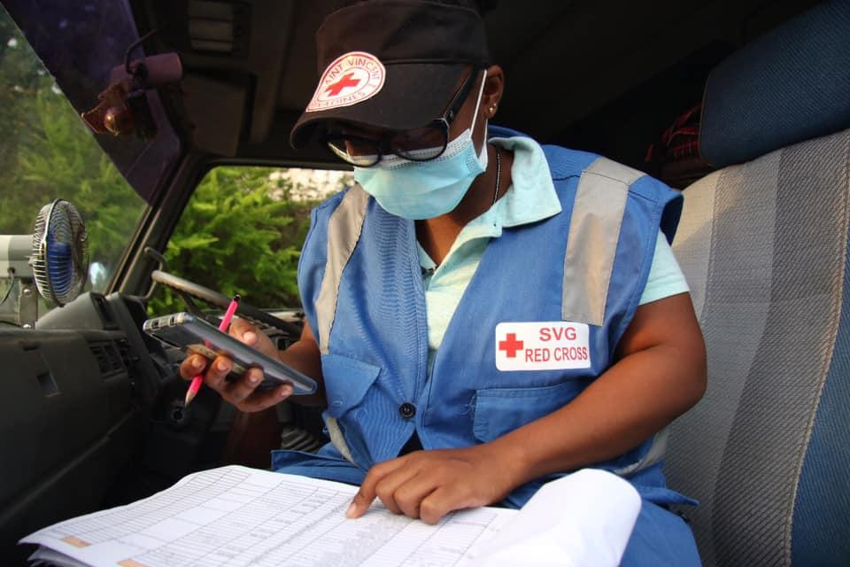
What is a Rapid Assessment?
It is a DANA that is conducted immediately after a disaster (within 24-72 hrs).
It provides information on needs, possible courses of action and resource requirements.
Notes:
A more detailed assessment will be carried out as the situation changes.

Slide 18

24 Hours and 72 Hours DANA Forms
Notes:
A more detailed assessment will be carried out as the situation changes.

Slide 19
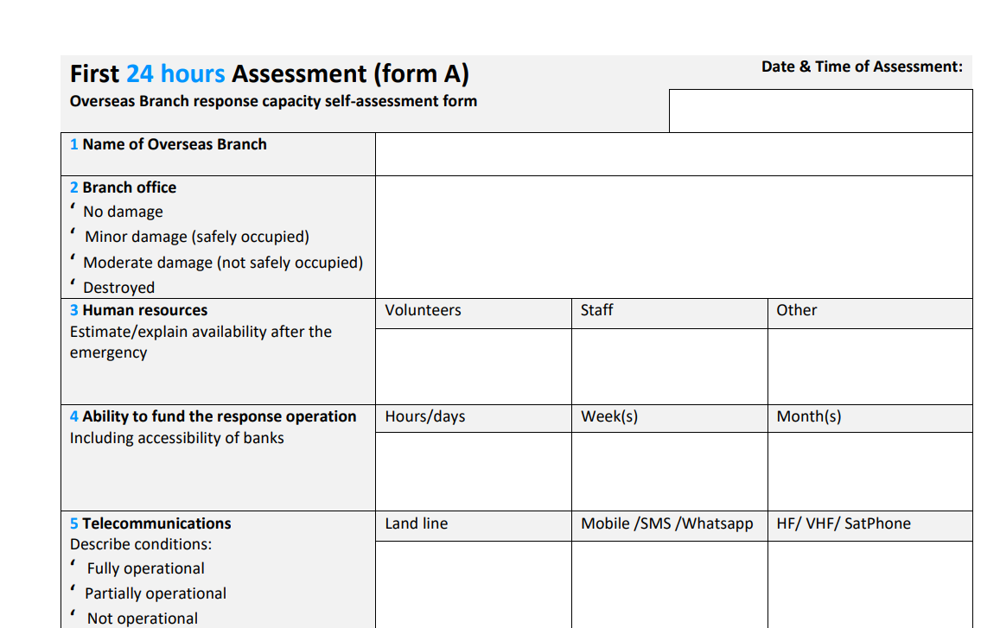
24 Hours
(Form A)
Notes:
Note: There is no need to go through each question. The forms were included so the participants can have an overview of the type of information being collected. This first form is used to conduct a response capacity self-assessment. The facilitator can ask why is it important for the branches to conduct a capacity self-assessment

Slide 20
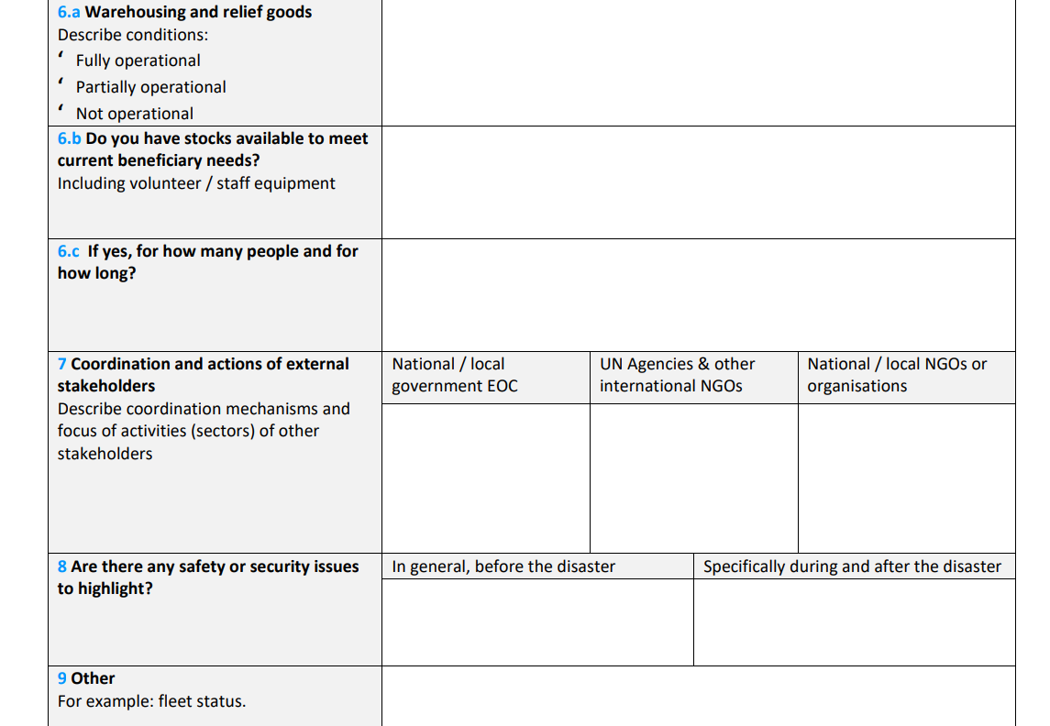
24 Hours
(Form A)

Slide 21
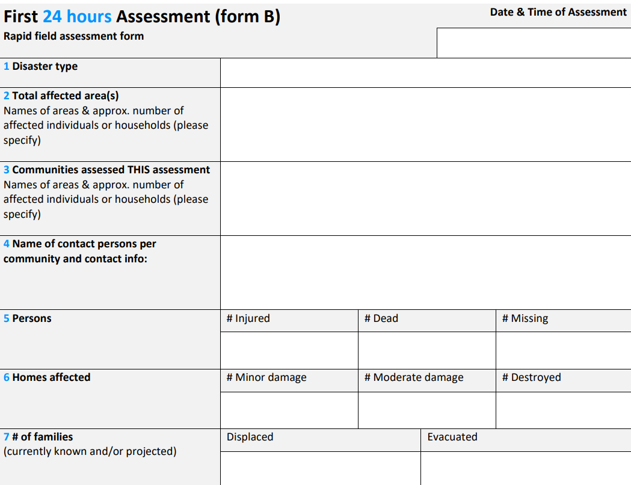
24 Hours
(Form B)
Notes:
This is the DANA form used in communities.

Slide 22
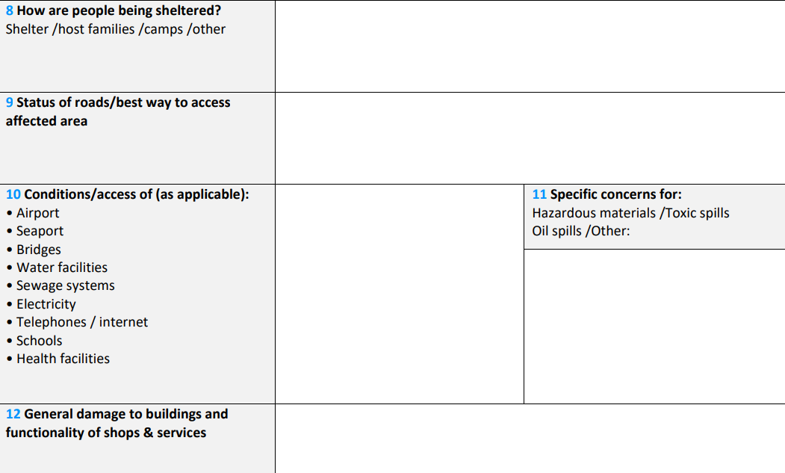
24 Hours
(Form B)

Slide 23
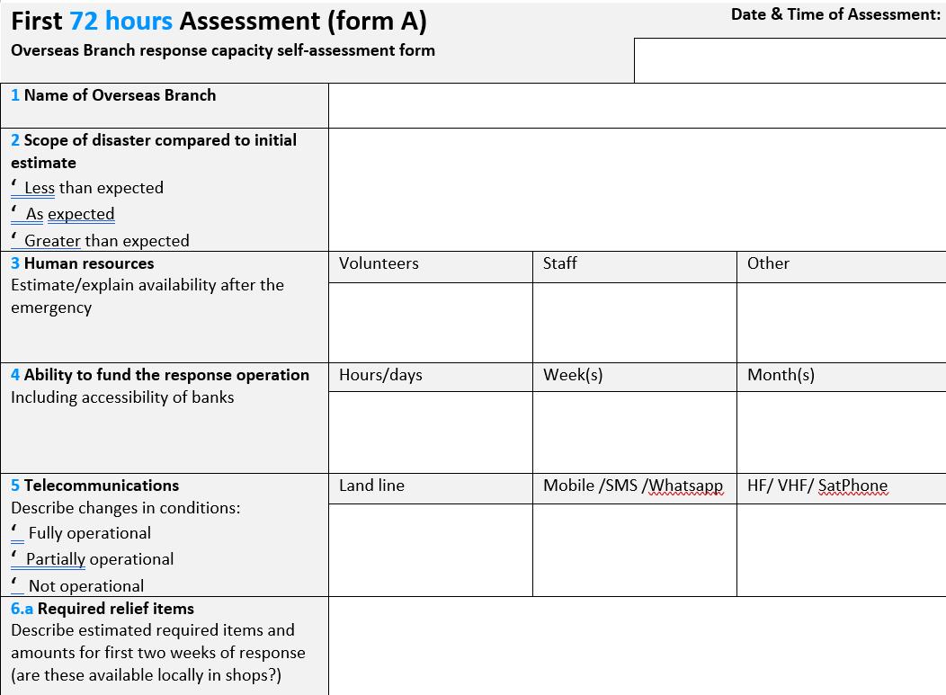
72 Hours
(Form A)
Notes:
There are subtle differences in this form compared the capacity self-assessment form used after 24 hours. Can anyone spot the differences?

Slide 24
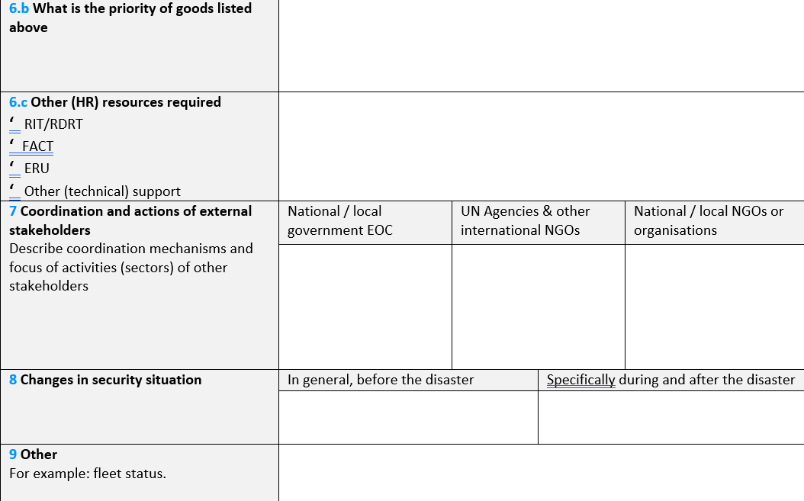
72 Hours
(Form A)
Notes:
There are subtle differences in this form compared the capacity self-assessment form used after 24 hours. Can anyone spot the differences?

Slide 25
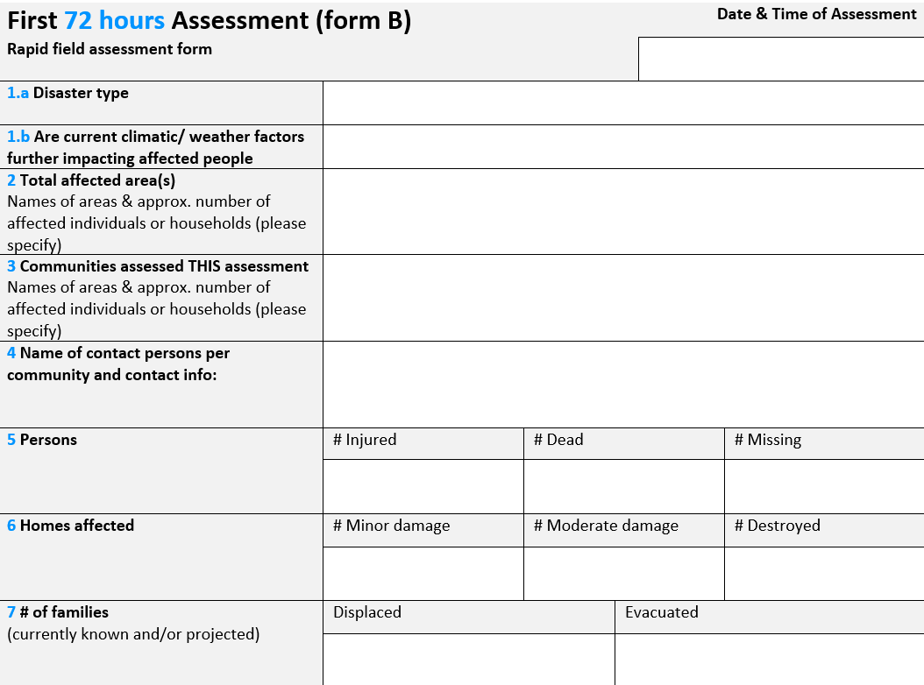
72 Hours
(Form B)
Notes:
There are subtle differences in this form compared the capacity self-assessment form used after 24 hours. Can anyone spot the differences?

Slide 26
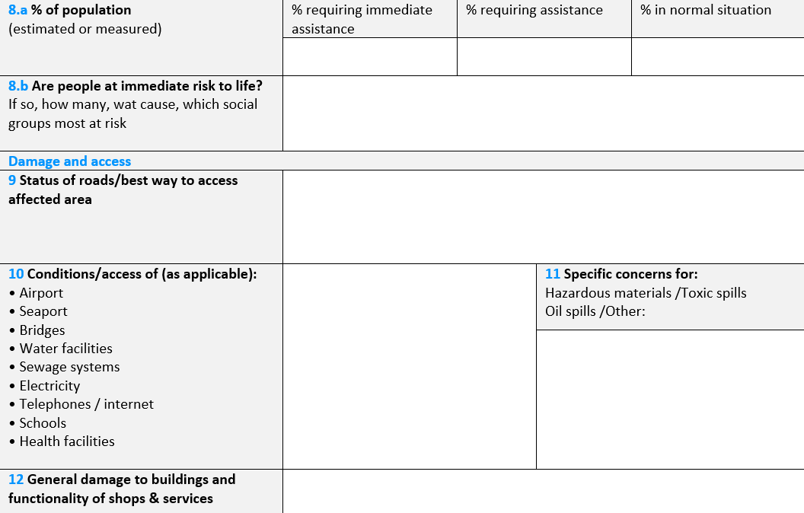
72 Hours
(Form B)
Notes:
There are subtle differences in this form compared the capacity self-assessment form used after 24 hours. Can anyone spot the differences?

Slide 27
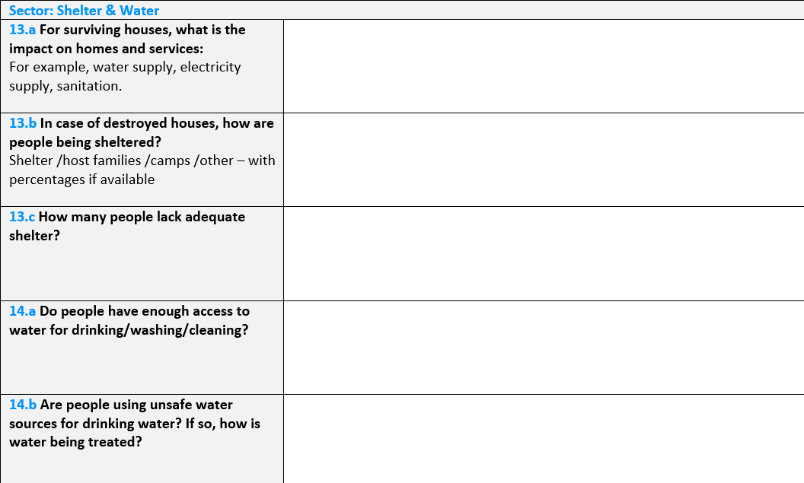
72 Hours
(Form B)
Notes:
You would notice that the 72 hours form asks more in-depth sector related questions.

Slide 28
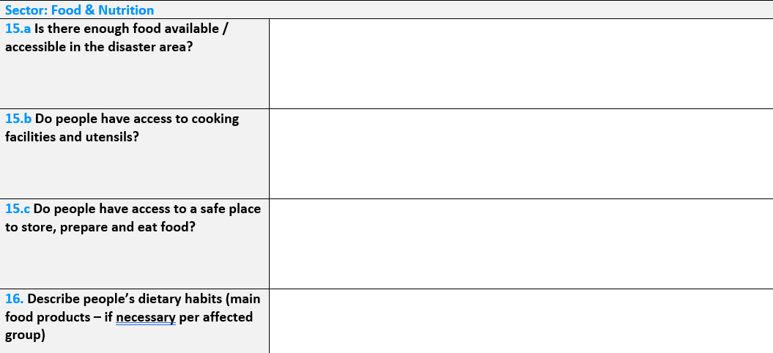
72 Hours
(Form B)
Notes:
You would notice that the 72 hours form asks more in-depth sector related questions.

Slide 29
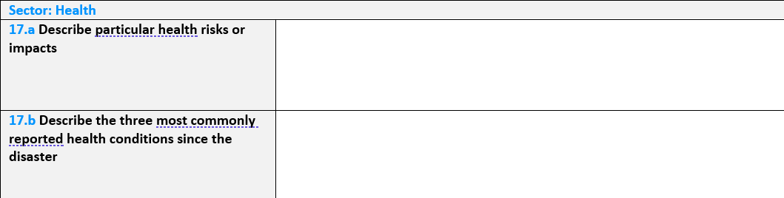
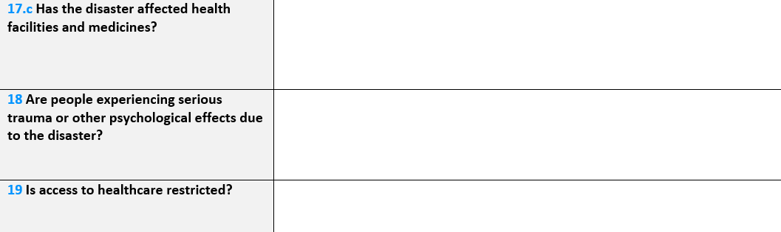
72 Hours
(Form B)
Notes:
You would notice that the 72 hours form asks more in-depth sector related questions.

Slide 30
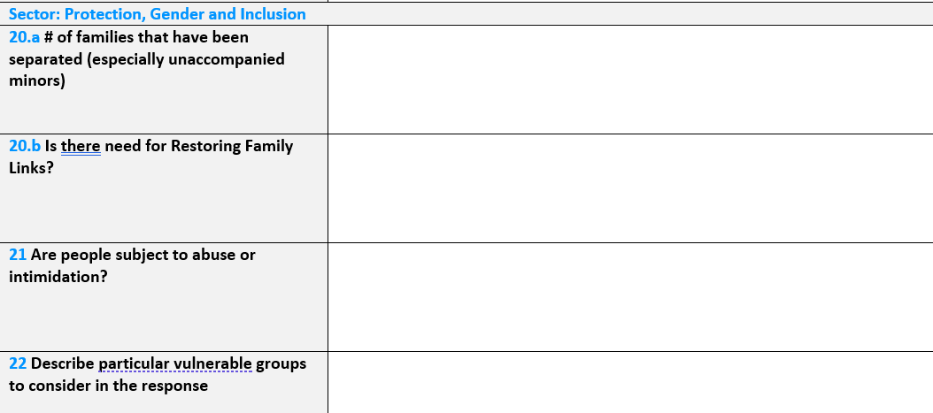
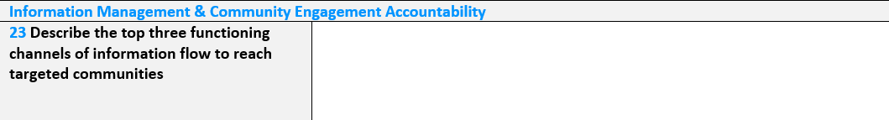
72 Hours
(Form B)
Notes:
You would notice that the 72 hours form asks more in-depth sector related questions.

Slide 31
What Are The Benefits Of Conducting A Rapid Assessment?
The information collected is needed for the development of an action and monitoring plan. The information helps decision-makers to:
Choose priorities, objectives and identify intervention alternatives.
Determine if outside help is needed.
Implement response based on these objectives and alternatives.
The aim is to help those who have been impacted, meet their immediate needs and save lives

Slide 32
After Class Activity
Review the Rapid Assessment Form used by your National Society (NS)/ National Disaster Office (NDO).
Become familiar with the type of information that is needed – you may have to use this form to assist your NS or NDO after a disaster.

Slide 33
Mentimeter
Q1: How prepared do you think your branch is to deal with a large-scale disaster?
Q2: What are some of things that your branch needs to become better prepared?

Slide 34
More realistically describe the needs of the most vulnerable
Forecast sector needs for the next 7-28 days and a projection for 1-3 months
Define alternatives for reducing immediate risks
Preparation of the longer-term Plan of Action
Revision of the Emergency Needs and Priority
Detail programming
Gauge local response capacity
Decide how best to use existing resources for immediate relief
Seek alternatives to response objectives and intervention
Purpose Of
A Detailed Assessment
Notes:
Note that only trained individuals will conduct a detailed assessment

Slide 35
How To Do
An Assessment
Strategy/Plan
Develop an outline of how you will go about doing your assessments, what methods and tools you will use.
Collection Methods
How will you select the areas, households or individuals you include in your assessment
Methods: interviews, observations – checklist, focus groups, secondary sources, conducting an Initial Damage Assessment (IDA).
Notes:
Sampling techniques: Simple Random, Alternate
Interviews: What is it? Structured, non structured interviews
Observations
Using checklists
Things to consider: Which areas do you go to? Do you go to known at-risk areas or poverty-stricken areas? It’s also important to know the agencies that will be on the ground and the type of information they would be collecting because you don’t want to overwhelm the community by having too many persons on the ground (from different agencies) asking the same questions.

Slide 36
Discussion:
Discuss the following questions:
What are some of the Dos and Don’ts when interacting with persons from an affected community?
What steps would you take if members of a community are hesitant to provide information?

Slide 37
Reporting
Know who you are reporting to and what information they need.
Coordinate with agencies on the field and ensure there is teamwork and communication of roles and expectations.
Describe the situation, what has happened?
Record Affected population, # of persons,# of families/households
Note Impact: Injuries, death, damage to livelihoods, infrastructure
Who is responding presently, what are they doing? What resources are available?
Where are the gaps. What is needed now?
What are the future needs of those affected?
Notes:
For point 2 – explain that this conversation is crucial to Red Cross’s role as an auxiliary to government, stress RC support role. More importantly, as CDRTs emphasise the support role to other agencies and doing no harm to agencies at work, avoiding duplication of efforts and doing no harm, while ensuring affected persons are getting assistance.
This is good opportunity to mention and discuss affected populations, also consider sex, age and disability disaggregated data.
damage to the natural environment/ecosystem. Reference to the Eco-based Approach EbA checklist or can be shared with interested persons.
Private Public Partnerships are also good to mention here, community members who can encourage small to medium business owners to support response actions or projects within the community before the event occurs. Examples are networking before the event with building and construction workers (for rebuilding), landscapers (equipment for debris removal), doctors, pharmacies (medication), shops (food supplies) etc.

Slide 38

Pit falls to avoid: Biases
Introduce yourself properly, don’t make promises
Let persons know why you are collecting information and who it will be shared with
Always get consent
Be respectful
Try to identify the gaps
Information collected must be accurate and reliable
Include vulnerable persons
Assistance should be given based on needs
Key Principles And Tips

Slide 39
Ongoing Community Monitoring And Surveillance: Recovery Process
The restoration, and improvement where appropriate, of facilities, livelihoods and living conditions of disaster-affected communities, including efforts to reduce disaster risk factors. (ISDR)
Why Assess Here?
To see how people are coping
How quickly is life is returning to normal?
Rebuilding resilience
Monitoring of ongoing programmes and needs

Slide 40



Working With Other Partners
Is a must and very crucial during Emergencies.
Discuss Partners’ Roles &
The Reporting Hierarchy
Respect Differences
Maintain Open Communication
And Transparency
Remember: You are working with others united by common motivation and vision with the purpose of planning executing cooperative activities according to clearly defined and accepted objectives.
Notes:
Ask participants to name other partner agencies that they might have to work with

Slide 41
Do some research into the disaster management framework of your branch and identify its partner agencies and reporting hierarchy.
Based on your research, you will:
Create an Organisational Structure for your island (similar to the Sint Marten Organisational Struture on Slide 13).
Write a paragraph or two describing the Organisational Structure.
You will work with other participants from your island. Be prepared to share your findings at the in-person training.
After Class Activity

Slide 42





Volunteer, Donate, Join Us In Partnership, or share our appeals and stories on social media. Find out more about IFRC and learn how to contact your National Red Cross or Red Crescent Society, at www.ifrc.org.
Get Involved
There are many ways of becoming a part of the world’s largest humanitarian network
To stay informed about Caribbean disaster response activities or to access additional information on available trainings, training materials, research and information management tools, visit: www.cadrim.org.
: CADRIM.IFRC
: @cadrim_ifrc
: @CADRIM_IFRC

